Slide 1

Governance aspects of the NQFs
Maria Rosenstock
Support to the establishment of Israel NQF | 24. September | ETF, Turin

Slide 2
FUNCTIONS OF QUALIFICATION SYSTEMS
Governance – policy, steering
Development, classification and description of qualifications standards and qualifications (by different sub-systems)
Assessment (including validation)
Quality assurance of qualifications
REGISTERING qualifications
For examples refer to ANNEX 3 of the ETF Toolkit and to Global Inventories

Slide 3
TYPICAL SOLUTIONS
Coordination Council/ Committee with a Secretariat
Agency with Governing Board (and additionally executive Board) and functional departments
Responsible Minister with Stakeholders Council

Slide 4
EXERCISE
Check the country reports in the Inventories:
Who has the overal coordinating role for NQFs (1)
Who populates the register (decides on inclusion of qualifications)
  Estonia
  Turkey
  Poland
  Azerbaijan* (discussion on the proposal)
  Relevance to Israel?

Slide 5
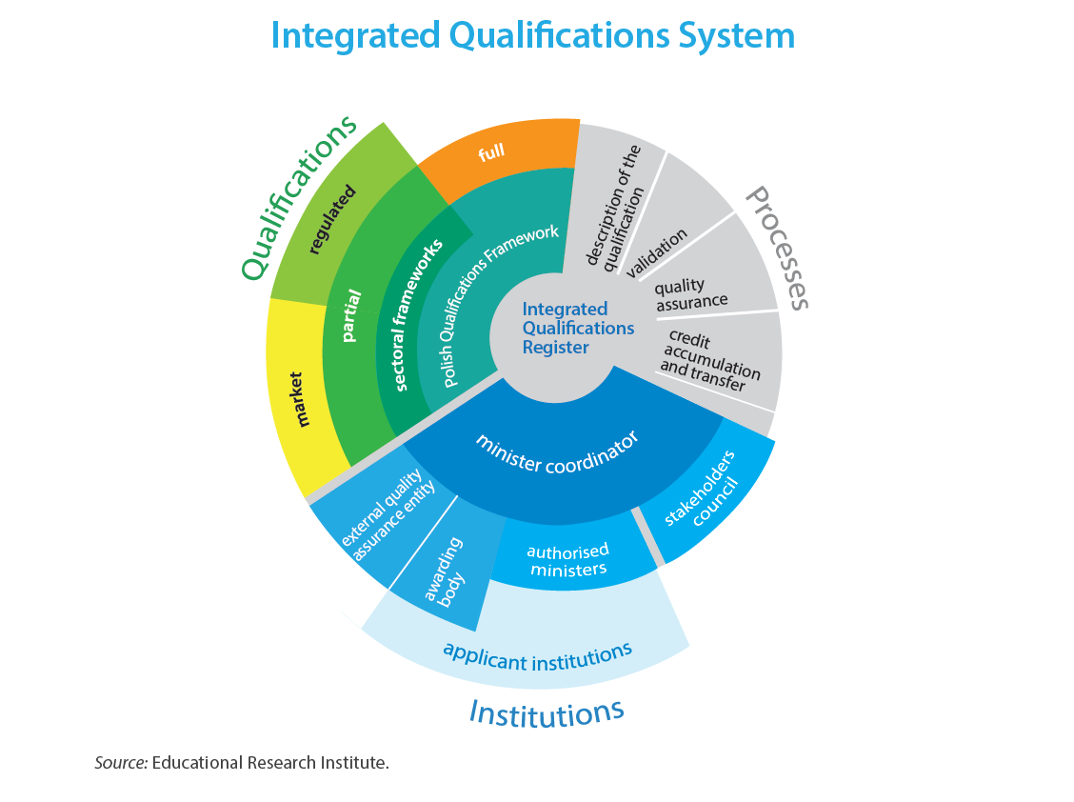
POLAND

Slide 6


