Slide 1
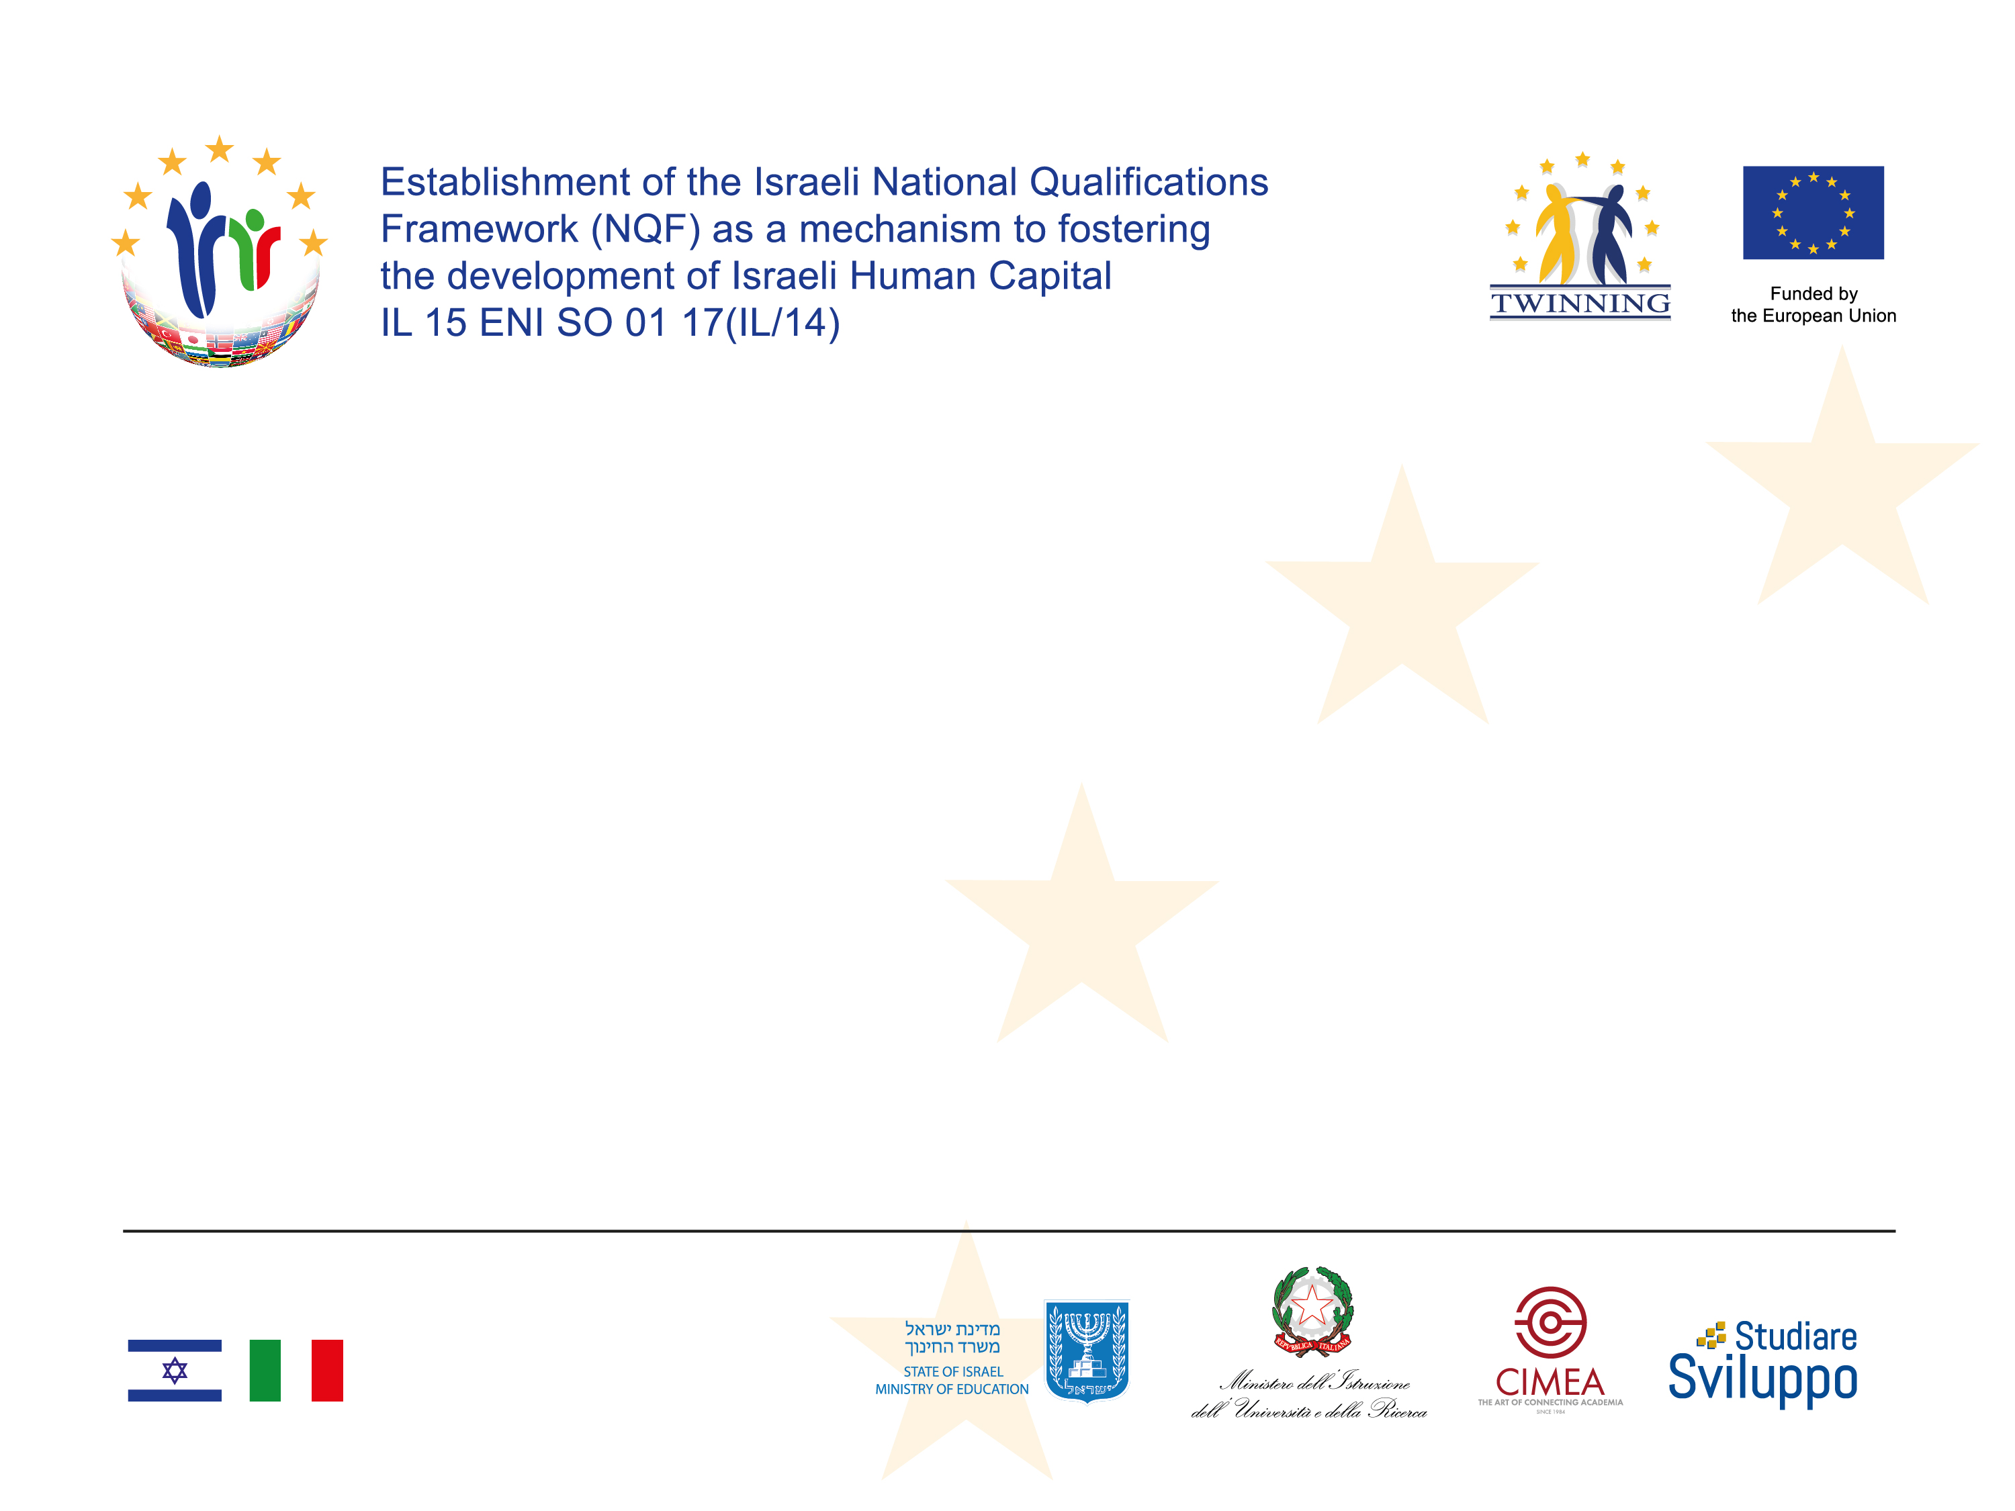
The Establishment of the Israeli
Qualifications Framework as a mechanism to fostering the development of Israeli Human Capital
Kick off meeting
Tel Aviv
August 30, 2018
Manuela Costone
Component Coordinator

Slide 2
KEY MESSAGES
The Israeli Qualifications Framework should be first of all an instrument of transparency, not a legal structure or binding for the country.
An internal legal framework for different education sectors already exists in Israel but the different legal acts are not connected: the NQF will present the entire picture of qualifications at national level, creating connections among sectors, starting from the current situation.
It is fundamental to maintain the nature of the framework as a flexible instrument that will be able to systematize the national legal framework instead of creating another legal instrument conflicting with the peculiatities of the national and cultural approach in different education sectors.

Slide 3
KEY WORDS FOR THE ISRAELI NQF
Israeli NQF
voluntary
tool
inclusive
need-based
process
flexible
International approach
agreed

Slide 4
Project components
COMPONENT | ACTIVITIES
0. Project Management and Visibility | Kick-off conference
 | Closure conference
 | Two Promotional events
1. Institutional Component | Official bodies involved and work plan
 | Define the goals and the nature of the Israeli NQF
 | Structural elements
 | Training activities and informative sections
 | Study visits
2. Structural Component | Quality assurance elements
 | Development of the NQF structure
 | Identify level descriptors
 | Adoption of the NQF
3. Legal Component | Legislative recommendations
 | Dissemination strategy
 | Referencing Report exercise

Slide 5
Institutional component
The Institutional component intends to support the establishment of the Israel NQF Entity, according to good practice(s), suitable to the Israeli reality and the Israeli pool of experts who will ensure the sustainability of the process, long after the life term of the project.
Mandatory result of the component:
Effective mechanisms have been identified and put in place by Israel's relevant administrations to disseminate and consolidate the development and implementation of the NQF

Slide 6
Institutional Component
1.1 | Official bodies involved and work plan -NQF inter-ministerial and stakeholders Working Group is organised in order to support the development and implementation of the National Qualifications Framework through the involvement of key stakeholders in education and training, including ministries and public institutions, providers and the social partners.
1.2 | Define the goals and the nature of the Israeli NQF - Guidance documents on governance options are submitted to relevant ministries (e.g. on a coordinating body such as a dedicated qualifications agency) based on analysis of potential roles of actors such as institutions, agencies, providers, social partners in the framework.
1.3 | Structural elements - A tailored model for the establishment of the Israeli NQF Entity has been developed (including of its structure, recommended staff composition, etc.) based on good practices of EU MSs
1.4 | Training activities and informative sections - Relevant Israeli NQF experts acquired the expertise and the capacity to ensure consolidation and implementation of the Israeli NQF and its alignment to the EQF.
1.5 | Study visits - Organisation of different study visits (i.e. one in another EU country relevant for the purpose of the project and one to the ETF) as poor sectorial needs as well as high rank officials of Israeli Ministries from the WG.

Slide 7
Structural component
This component, as the core result of this project, will define the structure of the Israeli NQF, and all its components
Mandatory result of the component:
The Israeli NQF report, describing all the features of the NQF and including a proposed set of strategic recommendations, is presented to relevant Israeli authorities.
The report will be available in English, Hebrew and Arabic for wide dissemination and public consultation.

Slide 8
Structural Component
2.1 | Quality assurance elements - Adoption of the NQF - Guidelines are developed to support the design of an inclusive and comprehensive framework with the relevant structure aiming at accommodating all quality assured qualifications in Israel.
2.2 | Development of the NQF structure - A roadmap is formulated and includes proposed level descriptors, procedures for levelling of qualifications for adoption to be endorsed by the main stakeholders.
2.3 | Identify level descriptors - Standards and criteria for the learning outcomes of Israeli qualifications are established (duly referring to the EQF criteria while adjusted to the Israeli reality), as well as guidelines on the process of validation of qualifications and lifelong learning.
2.4 | Adoption of the NQF - The database for Israeli qualifications and its corresponding website are available.

Slide 9
Legal component
The project aims, through the implementation of all components, to give a clear picture of the process, and by the dissemination of the strategy paper, as well as other indicative results mentioned, to enable the Israeli authorities to establish the legal framework for the Israeli NQF.
Mandatory result of the component:
A strategy paper "the Israeli Qualifications Framework-Starting points policy paper" that includes legislative recommendations will be presented to relevant Israeli authorities

Slide 10
Legal Component
3.1 | Legal Component - A strategy paper "the Israeli Qualifications Framework-Starting points policy paper" that includes legislative recommendations is drafted and disseminated.
3.2 | Dissemination strategy - Disseminate the NQF at national level organising workshops targeting different stakeholders and draft the national dissemination strategy of the NQF
3.3 | Referencing Report exercise - Starting an exercise at national level in order to reference national qualifications levels to the EQF.

Slide 11
3 Key Experts are responsible for the implementation of the Project Components and for the coordination of the STEs, under the supervision of the PL and RTA
Ms. Manuela Costone, Component 1 coordinator
Senior Adviser at CIMEA, she is expert in Bologna Process and internationalization of the Higher Education Sector. She is also the project manager of the ECGFA-NET - European Coast Guard Functions Academy Network in order to draft the Sectoral Qualification Framework for Coast guard Functions and senior project manager in EU projects linked to the implementation and application of the European Qualification Framework.
Director of CIMEA, the Italian ENIC-NARIC centre, former vice-President of the ENIC Bureau and National Correspondent for the Italian Qualifications Framework at the Council of Europe. His research activity is focused on professional and academic recognition, qualifications frameworks, internationalization strategies and mobility programmes.
Policy officer at the Office for Internationalization of the Higher education (MIUR), she is in charge to implement bilateral policies and to manage activities and policies connected with foreign students in bilateral mobility. She manages activities with the Italian Ministry of Foreign Affairs and with the diplomatic network and she is in charge to draft different acts related to the implementation of international tools according to the EU decisions/directives, Bologna Process and EHEA.
Mr. Luca Lantero, Component 2 coordinator
Ms. Maria Antonietta Scalera, Component 3 coordinator

Slide 12
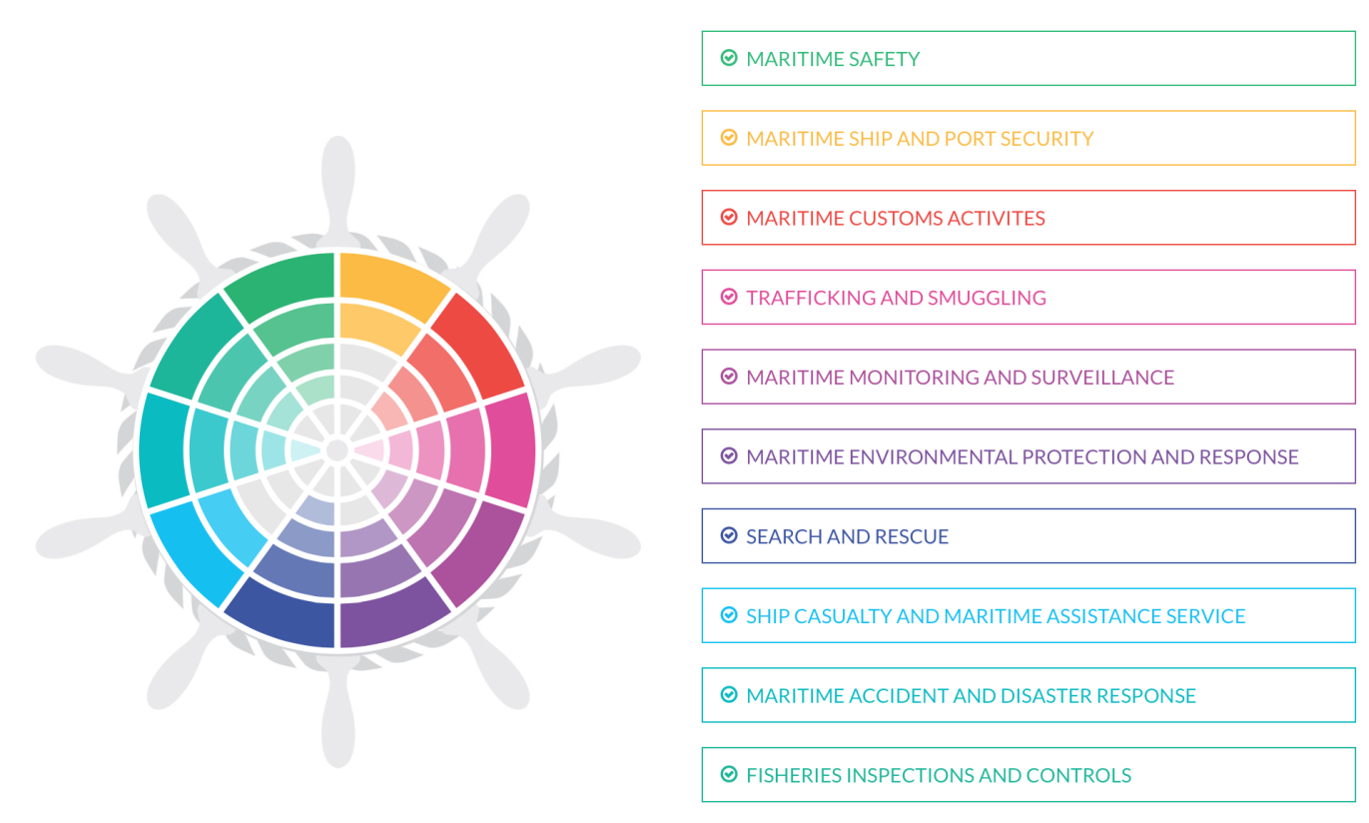
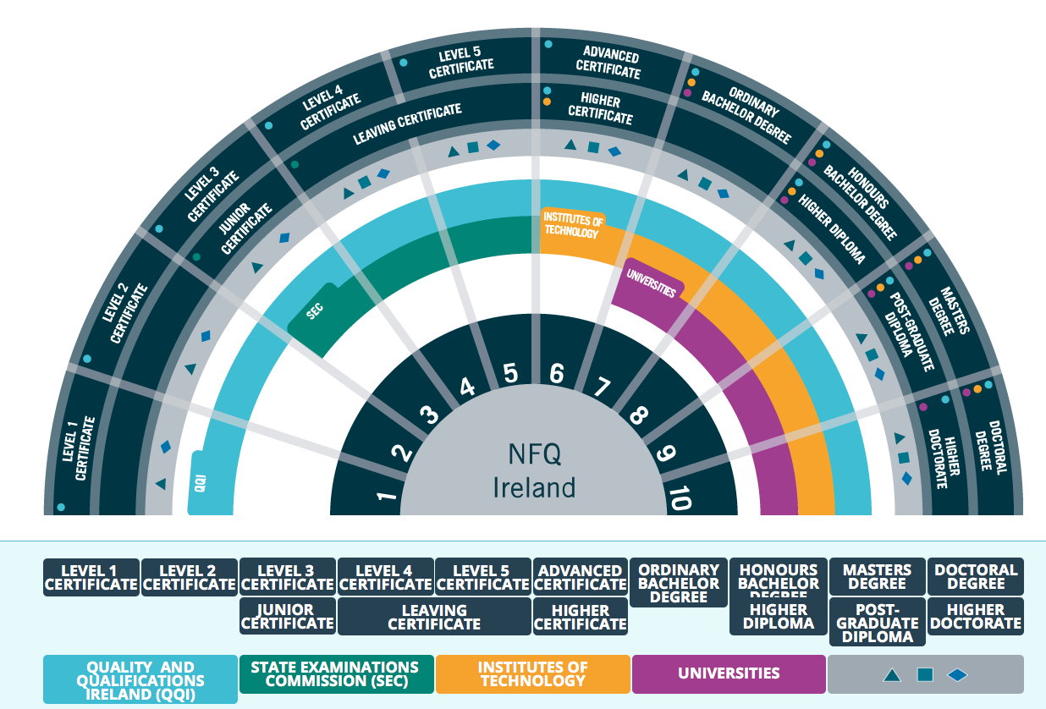
VISIBILITY AND VISUAL IDENTITY
A Brand Identity of a NQF is fundamental to present this instrument and to help users in order to use it at national and at international level.

Slide 13
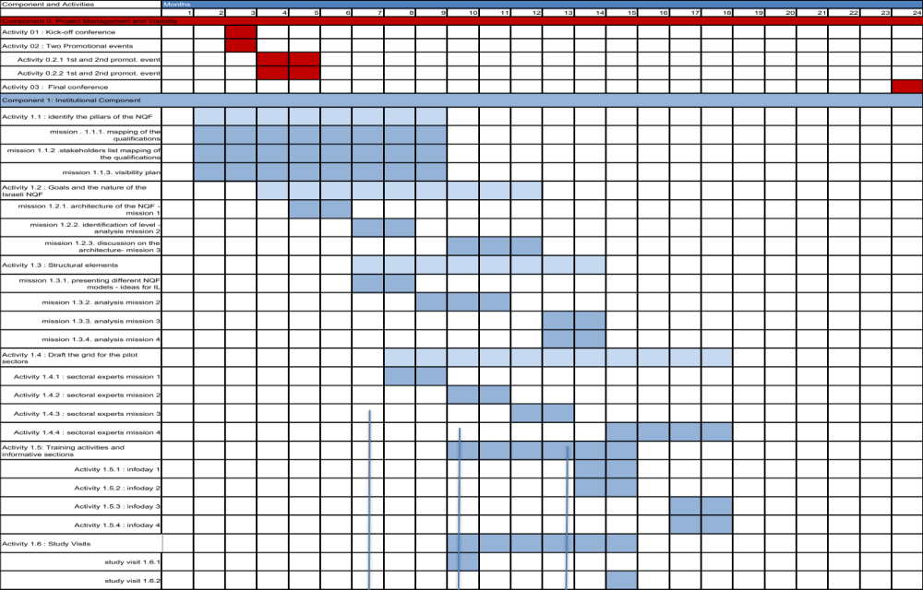
Schedule

Slide 14
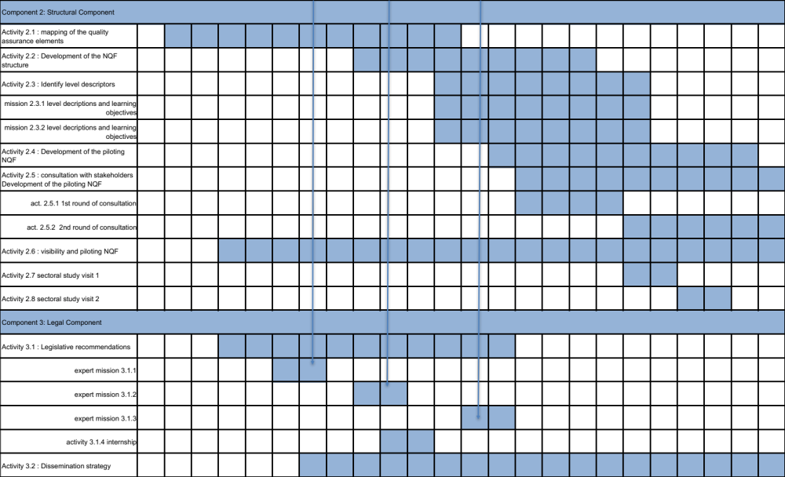
Schedule

Slide 15

Thank you for your attention
Manuela Costone
m.costone@cimea.it

