Slide 1

Level 5 in Israel
an issue of agreeing level or about comparability of qualification types?
Arjen Deij

Slide 2

What I understand so far
Different programmes offered at level 5 under the responsibilities of different institutions since a long time
High skilled technicians L4 and practical engineers L5 are in demand
Interest from students is decreasing
Current programmes lack flexibility and are not enough focused on productivity

Slide 3
What I understand so far
In the scope of NQF there is the intention to see how qualifications can be better linked
There is an interest to involve more stakeholders from the world of work
The state should not prescribe how existing qualifications should be redefined
Israel is interested to learn from international experience

Slide 4
What is happening elsewhere
Some countries have reinvented their level 5 qualifications (F, SW, UK, NL, SLO, KAZ) others struggle with redefining inherited L5 qualifications (UA, TK), some countries are considering to introduce L5
Sometimes L5 is short cycle HE, sometimes VET, sometimes both, sometimes there are different types of qualifications

Slide 5
  What makes qualifications meaningful?

Slide 6
How to ensure that qualifications are meaningful?
EMPLOYERS | INDIVIDUALS | SOCIETY
RECRUITMENT RELEVANCE SPECIFICITY COMPETENCE ADAPTABILITY ACCOUNTABILITY RETURN ON INVESTMENT LEGAL OBLIGATIONS | MOBILITY PROGRESSION PORTABILITY BREADTH CAREER DEVELOPMENT INDIVIDUAL DEVELOPMENT RECOGNITION REWARD | EDUCATED AND ACTIVE CITIZENS BASIC NUMERACY, LITERACY CULTURAL IDENTITY ACCOUNTABILITY PROGRESSION QUALIFIED WORKFORCE EMPLOYABILITY MOBILITY

Slide 7
How to ensure that qualifications are meaningful?
EMPLOYERS | INDIVIDUALS | SOCIETY
RECRUITMENT RELEVANCE SPECIFICITY COMPETENCE ADAPTABILITY ACCOUNTABILITY RETURN ON INVESTMENT LEGAL OBLIGATIONS | MOBILITY PROGRESSION PORTABILITY BREADTH CAREER DEVELOPMENT INDIVIDUAL DEVELOPMENT RECOGNITION REWARD | EDUCATED AND ACTIVE CITIZENS BASIC NUMERACY, LITERACY CULTURAL IDENTITY ACCOUNTABILITY PROGRESSION QUALIFIED WORKFORCE EMPLOYABILITY MOBILITY

Slide 8
How to ensure that qualifications are meaningful?
EMPLOYERS | INDIVIDUALS | SOCIETY
RECRUITMENT RELEVANCE SPECIFICITY COMPETENCE ADAPTABILITY ACCOUNTABILITY RETURN ON INVESTMENT LEGAL OBLIGATIONS | MOBILITY PROGRESSION PORTABILITY BREADTH CAREER DEVELOPMENT INDIVIDUAL DEVELOPMENT RECOGNITION REWARD | EDUCATED AND ACTIVE CITIZENS BASIC NUMERACY, LITERACY CULTURAL IDENTITY ACCOUNTABILITY PROGRESSION QUALIFIED WORKFORCE EMPLOYABILITY MOBILITY

Slide 9
  Basic notions
  Linking labour market needs with what students should learn

Slide 10
What to learn
How to learn
Qualification standards
Jobs
Curricula
Students
Occupational standards
Educational standards
Notes:
10

Slide 11
What to learn
How to learn
DEFINE REQUIRED COMPETENCES FOR EVERY SINGLE JOB
Qualification standards
Jobs
Curricula
Students
Occupational standards
Educational standards
Notes:
11

Slide 12
What to learn
How to learn
DEFINE THE COMPETENCES FOR EACH OCCUPATION
Qualification standards
Jobs
Curricula
Students
Occupational standards
Educational standards
Notes:
12

Slide 13
What to learn
DEFINE THE REQUIREMENTS FOR ASSESSMENT & CERTIFICATION TO DEMONSTRATE COMPETENCE
How to learn
Qualification standards
Jobs
Curricula
Students
Occupational standards
Educational standards
Notes:
13

Slide 14
What to learn
How to learn
Qualification standards
Jobs
Curricula
Students
Occupational standards
Educational standards
NATIONAL CURRICULUM FRAMEWORK FOR LEARNING
Notes:
14

Slide 15
What to learn
How to learn
Qualification standards
Jobs
Curricula
Students
Occupational standards
Educational standards
TRAINING PROGRAMMES AT THE PROVIDER LEVEL
Notes:
15

Slide 16
What to learn
How to learn
Qualification standards
Jobs
Curricula
Students
Occupational standards
Educational standards
INDIVIDUAL LEARNING PROGRAMME FOR EACH STUDENT
Notes:
16

Slide 17
  Basic notions
  Defining vocational qualifications

Slide 18


Labour Market
CBQ
developing qualifications
18

Slide 19

Labour Market
Skills Anticipation
CBQ
developing qualifications
19

Slide 20

Labour Market
Skills Anticipation
OS1
OS2
OS 3
CBQ
developing qualifications
20

Slide 21
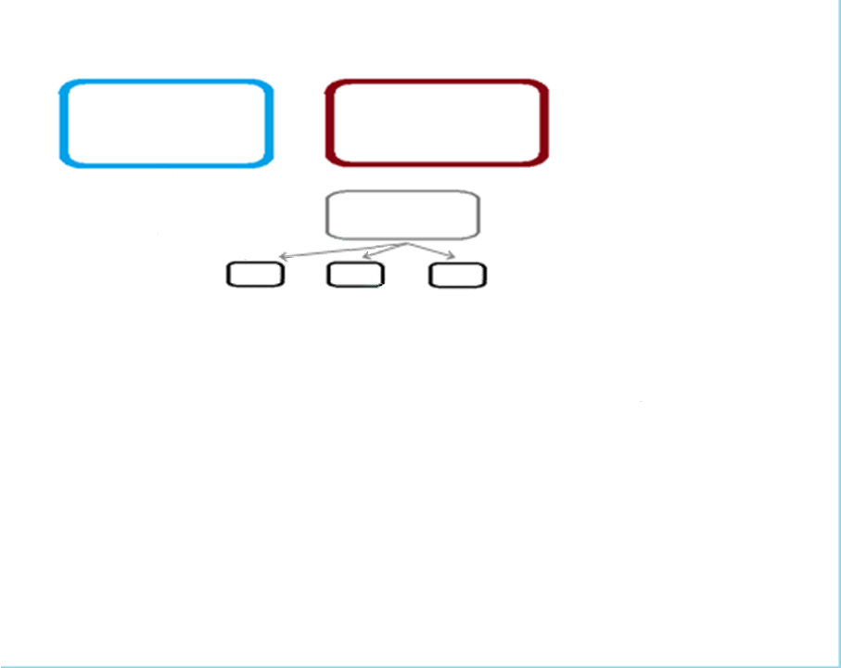
Education Policy Objectives
Labour Market
Skills Anticipation
OS1
OS2
OS 3
CBQ
developing qualifications

Slide 22
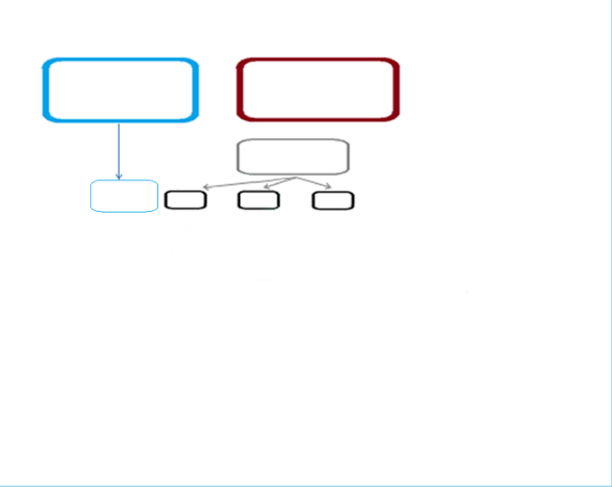
Education Policy Objectives
Labour Market
Skills Anticipation
Access & Progression
OS1
OS2
OS 3
CBQ
developing qualifications

Slide 23
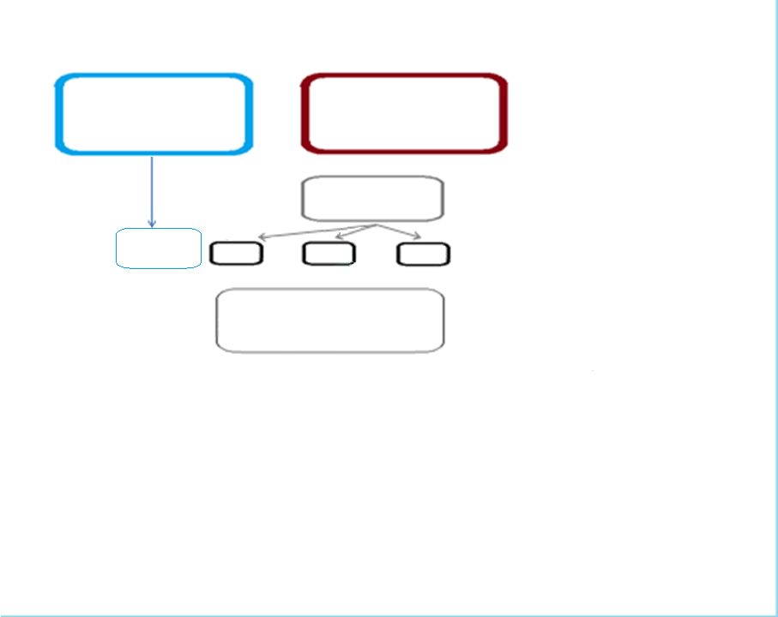
Education Policy Objectives
Labour Market
Skills Anticipation
Access & Progression
OS1
OS2
OS 3
Qualification Types
CBQ
developing qualifications

Slide 24
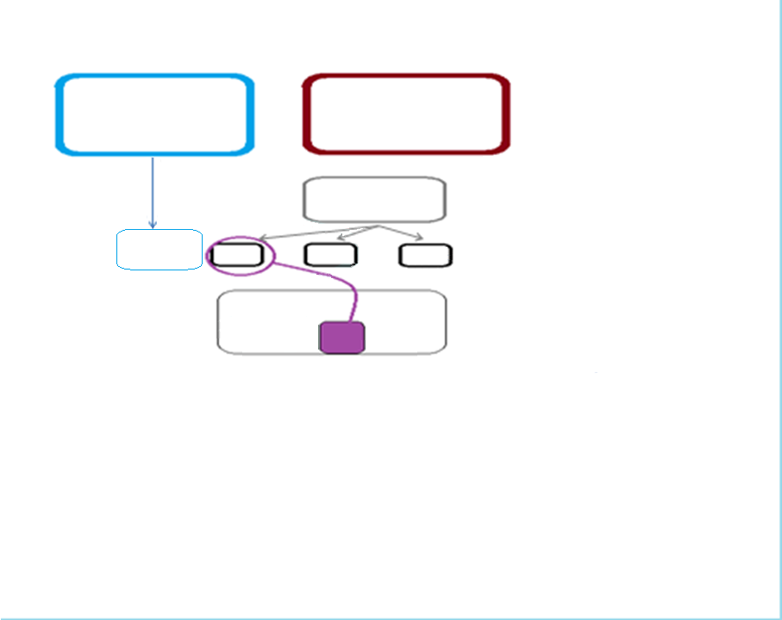
Education Policy Objectives
Labour Market
Skills Anticipation
Access & Progression
OS1
OS2
OS 3
Qualification Types
CBQ
developing qualifications
CBQ* - Competency based qualification = learning outcomes are identical to work-related competences as described in the occupational standard

Slide 25
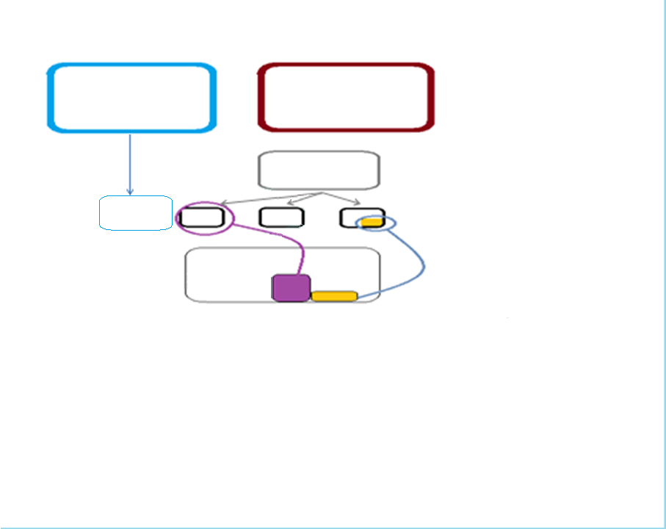
Education Policy Objectives
Labour Market
Skills Anticipation
Access & Progression
OS1
OS2
OS 3
Qualification Types
CBQ
Spec. Cert.
developing qualifications

Slide 26
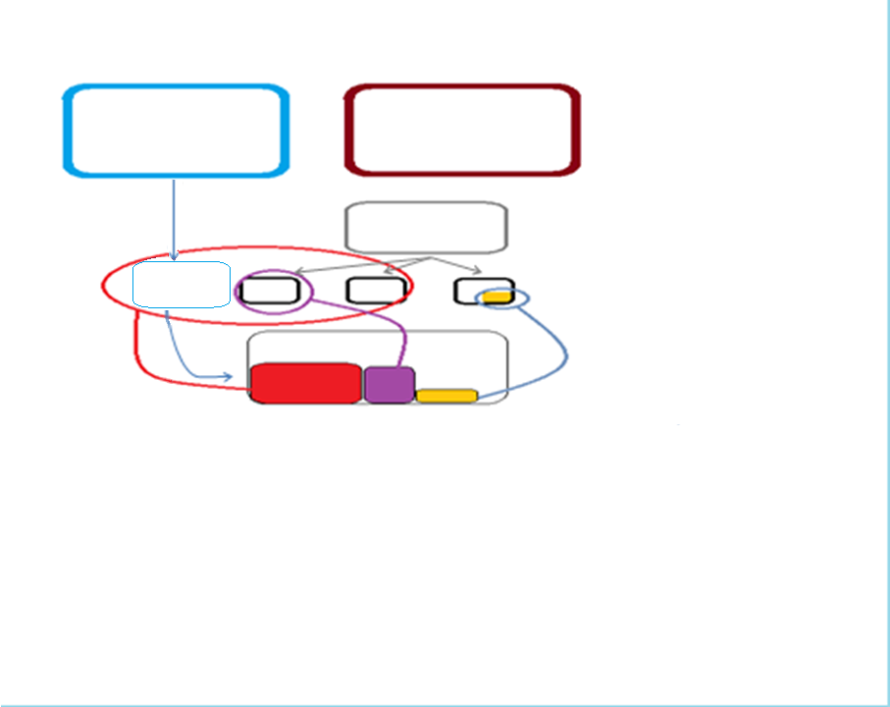
Education Policy Objectives
Labour Market
Skills Anticipation
Access & Progression
OS1
OS2
OS 3
Qualification Types
2ndary VET Qual
CBQ
developing qualifications
Spec. Cert.

Slide 27
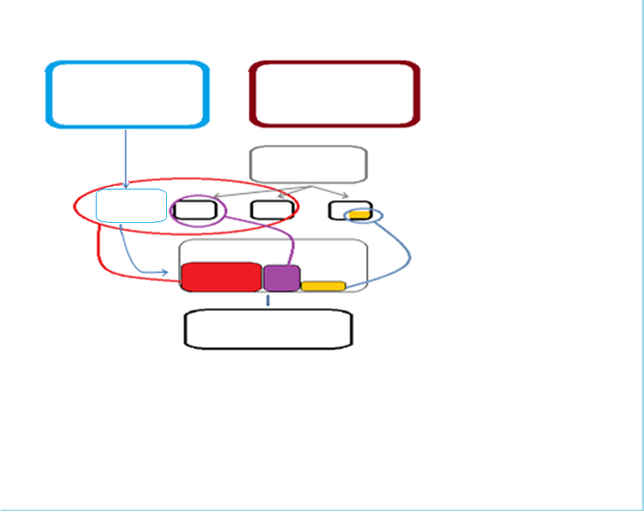
Education Policy Objectives
Labour Market
Skills Anticipation
Access & Progression
OS1
OS2
OS 3
Qualification Types
2ndary VET Qual
CBQ
developing qualifications
Spec. Cert.
Individual qualification standard

Slide 28
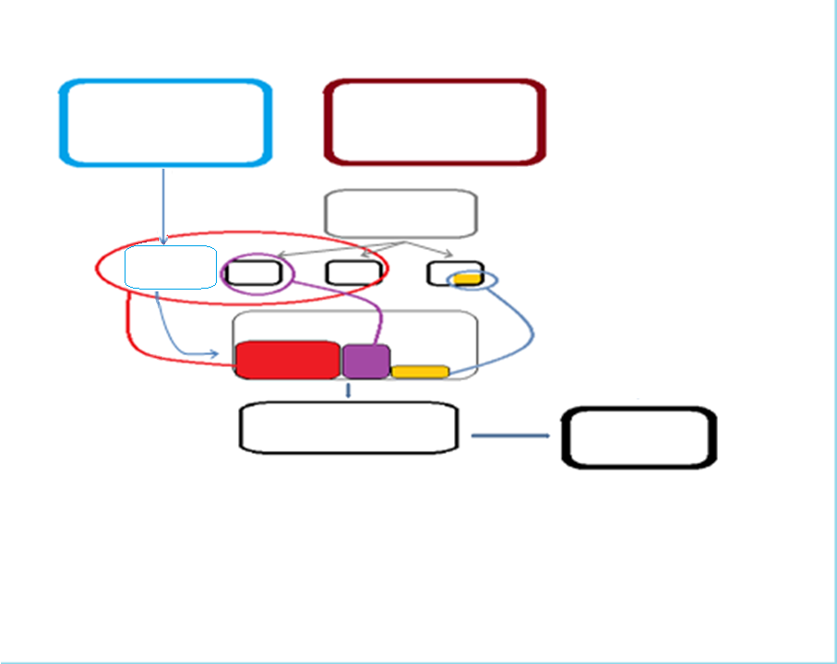
Education Policy Objectives
Labour Market
Skills Anticipation
Access & Progression
OS1
OS2
OS 3
Qualification Types
2ndary VET Qual
CBQ
developing qualifications
Spec. Cert.
Individual qualification standard
Final Assessment

Slide 29
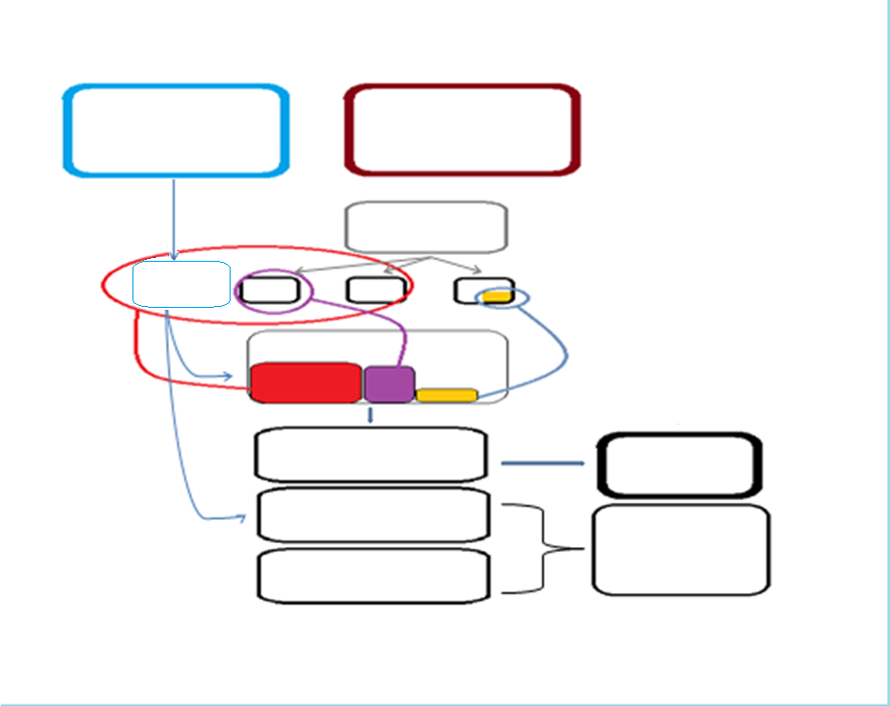
Education Policy Objectives
Labour Market
Skills Anticipation
Access & Progression
OS1
OS2
OS 3
Qualification Types
2ndary VET Qual
CBQ
developing qualifications
Spec. Cert.
Individual qualification standard
Final Assessment
Educational standard Basic study plan
Taught curriculum
Study programme of provider

Slide 30
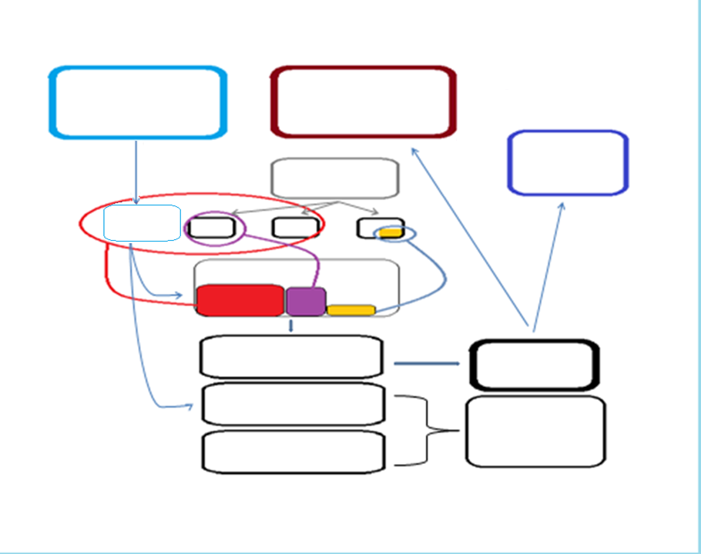
Education Policy Objectives
Labour Market
Further learning
Skills Anticipation
Access & Progression
OS1
OS2
OS 3
Qualification Types
2ndary VET Qual
CBQ
developing qualifications
Spec. Cert.
Individual qualification standard
Final Assessment
Educational standard Basic study plan
Taught curriculum
Study programme of provider

Slide 31
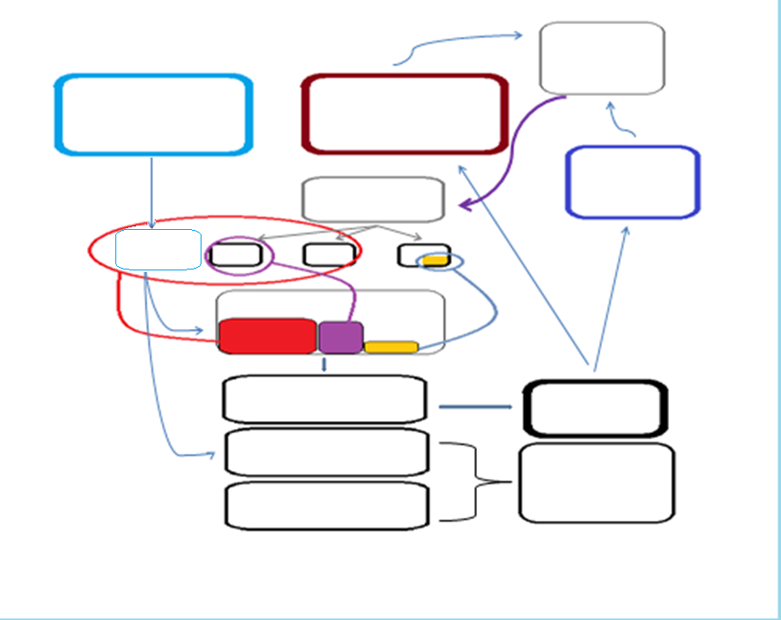
Feedback from and about graduates
Education Policy Objectives
Labour Market
Further learning
Skills Anticipation
Access & Progression
OS1
OS2
OS 3
Qualification Types
2ndary VET Qual
CBQ
developing qualifications
Spec. Cert.
Individual qualification standard
Final Assessment
Educational standard Basic study plan
Taught curriculum
Study programme of provider

Slide 32
  Basic notions
  What do we mean with qualifications and qualification standards?

Slide 33


Starting point: A formal certificate
‘QUALIFICATION’
means a formal outcome of an assessment and validation process which is obtained when a competent body determines that an individual has achieved learning outcomes to given standards.
Qualification
Notes:
33

Slide 34

What is behind the certificate?
Qualification
Notes:
34

Slide 35
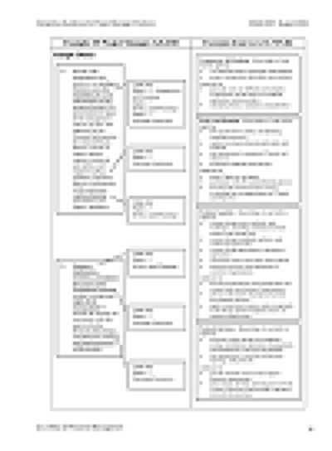
A standard that describes what a individual should be able to do in order to get the certificate
Formal Requirements
Notes:
35

Slide 36
  Basic notions
  Learning outcomes

Slide 37
USING LEARNING OUTCOMES
Well-known concept:
«Learning outcomes determine what the learner knows, understands, or is able to do at the end of the learning process».
(Source EQF Recommendation)
Common interpretation
Learning outcomes are an alternative way to identify and develop education, training and qualifications. There is a shift from the input criteria for learning (duration, type of education, location, program, institution, etc.) to the learning outcomes

Slide 38
USING LEARNING OUTCOMES
Compare the following statements :
I know EXCEL.
I use EXCEL every day.
I completed an EXCEL training course.
I have a certificate of ECDL (European Computer Drivers License).
I know how to work in EXCEL.
I am able to perform simple mathematical operations in EXCEL.
I am able to do regression analysis using computer programs.
All statements give information about my knowledge, skills & competencies.
Not all of these statements are learning outcomes.
Only two statements are really learning outcomes.

Slide 39
  Defining Qualification Types

Slide 40
EQF LEVEL DESCRIPTORS FOR L5
Level Knowledge Skills Responsibility & Autonomy
Level 5 | comprehensive, specialised, factual and theoretical knowledge within a field of work or study and an awareness of the boundaries of that knowledge | a comprehensive range of cognitive and practical skills required to develop creative solutions to abstract problems | exercise management and supervision in contexts of work or study activities where there is unpredictable change review and develop performance of self and others

Slide 41

Possible other criteria for identifying qualification types
Purpose?
Structure? Size/Duration/Credit value/Full/partial/combined
Broad learning outcomes
External requirements? linked to international and national standards and legal or regulatory requirements
Currency/portability? Where can the qualification be used?
Awarding body?
Regulator/ External QA body?
Pathway?

Slide 42
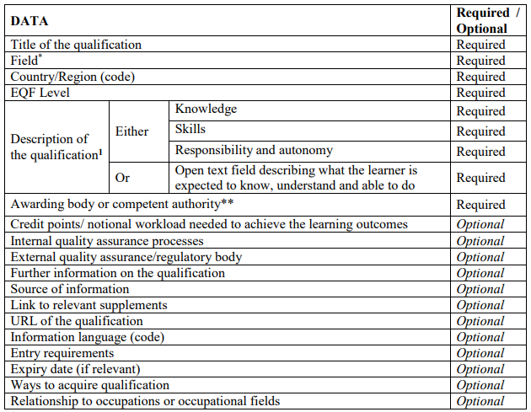

Slide 43

Example
Qualification types
Doctoral degree characteristics and Master's degree characteristics provide information about the purposes, content, assessment methods and titles of different types of UK doctoral and master's degrees. They are additional reference points to provide advice and guidance for those responsible for doctoral and master's programmes.
  Doctoral Degree Characteristics
  Master’s Degree Characteristics
  Foundation Degree Qualification Benchmark
Notes:
Note current European project — Quality Assurance of Cross-border Higher Education (QACHE):
‘Between 1 October 2013 and 31 December 2015, the project will look closely into different ways in which European quality assurance agencies and higher education institutions address the accreditation and quality assurance of the programmes delivered outside their countries.’
Project members:
ENQA (lead)
European agencies (including QAA)
TEQSA (Australia)
Arab Network for Quality Assurance in Higher Education (ANQAHE)
Asia-Pacific Quality Network (APQN)
Milestone activities include:
Online survey of agencies
Country reports (currently being drafted)
Gathering case studies and good practice
Three regional forums (Europe, Gulf States, Asia)
Final conference
With the final report to European Commission by January 2016

Slide 44
Example
Foundation Degree Qualification
Benchmark
Goal
‘Foundation Degrees integrate academic and work-based learning through close collaboration between employers and programme providers. They build upon a long history of design and delivery of vocational qualifications in higher education, and are intended to equip learners with the skills and knowledge relevant to their employment, so satisfying the needs of employees and employers.
Foundation Degrees are located within level 5 of The framework for higher education qualifications in England, Wales and Northern Ireland (FHEQ) …. [they do not] represent an end of first cycle higher education qualification in terms of the Bologna declaration.’
Notes:
QAA’s most recent TNE review — United Arab Emirates in February 2014, centred on Dubai
Two particular themes for this review:
Looking at the branch campuses model (popular with UK providers operating in the UAE)
Delivery of business administration programmes, including MBA qualifications
We worked closely with Dubai’s Knowledge and Human Development Authority (KHDA):
Formal Memorandum of Understanding
KHDA representatives participated in a number of visits
Review reports were published in June 2014

Slide 45
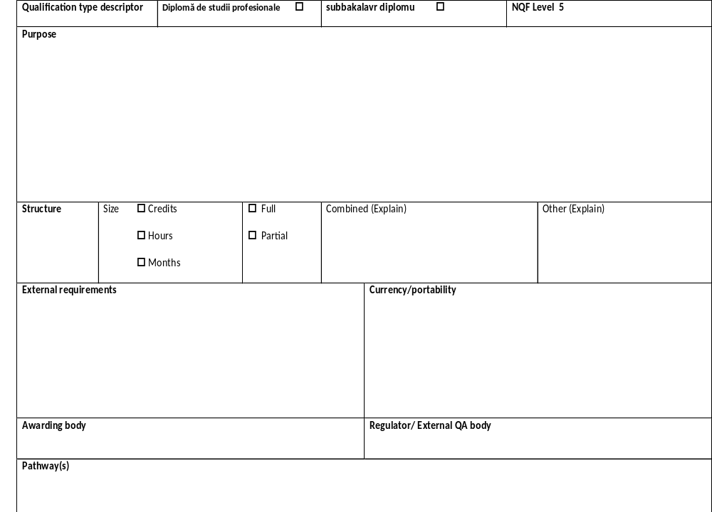

Slide 46


