Slide 1
FUTURE GENERATION of Interoperable NQF DATABASES in EUROPE
Arjen DEIJ, European training foundation

Slide 2
ESCO
Multilingual classification of European Skills, Competences, Qualifications and Occupations.

Slide 3
What is esco?
ESCO
identifies and categorises skills, competences, qualifications and occupations relevant for labour market and education and training
systematically shows the relationships between the different concepts

Slide 4
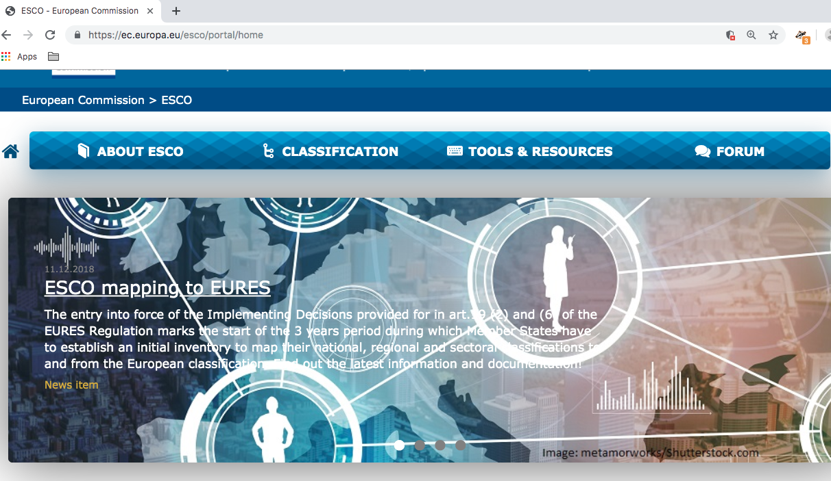

Slide 5
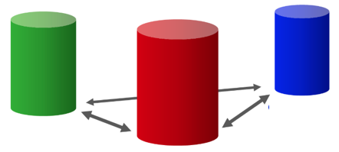
The three esco pillars
qualifications
occupations
skills

Slide 6
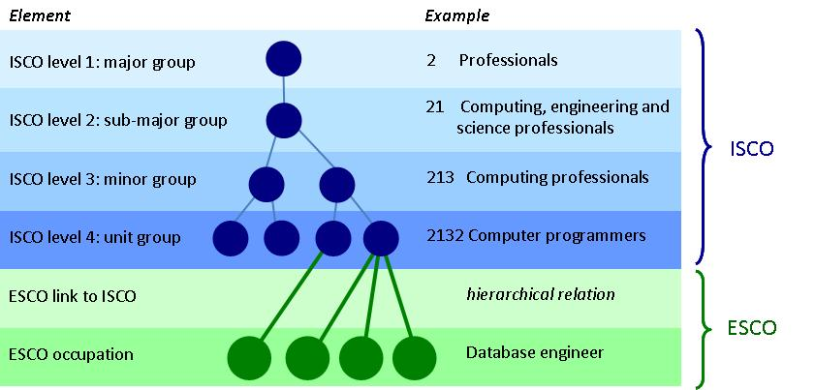
Occupations pillar

Slide 7
Search occupations pillar
2 Professionals
25 Information and communications technology professionals
  252 Database and network professionals
    2521 Database designers and administrators
      database developer
      Database developers program, implement and coordinate changes to computer databases based on their expertise of database management systems.

Slide 8
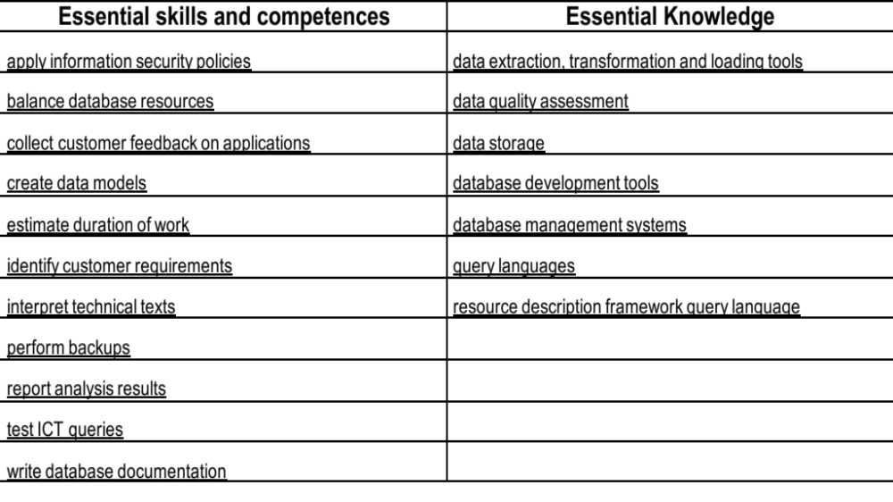
ESCO distinguishes essential and optional knowledge, skills and competences.

Slide 9
Moving from occupations to skills pillar
Searching skills, you can choose
All skills
Transversal skills and competences
Digital competences
Language
The skills pillar contains not only skills, but knowledge, skills and competences. ESCO distinguishes between i) skill/competence concepts and ii) knowledge concepts,

Slide 10
Example of skills description
Create data models
Use specific techniques and methodologies to analyse the data requirements of an organisation's business processes in order to create models for these data, such as conceptual, logical and physical models. These models have a specific structure and format.

Slide 11
HOW TO search 13,500 elements in skills pillar
Relationship with occupations, i.e. by using occupational profiles as entry point;
In the part of the transversal knowledge, skills and competences through a skills hierarchy;
Relationships of affiliated knowledge, skills and competences skill contextualisation
Through functional collections that allow to select subsets of the skills pillar.
Experts are working on better interfaces

Slide 12
Qualifications pillar
Qualifications in ESCO come from national qualifications databases. Qualifications are included in NQF that have been referenced to the EQF
Countries develop national qualifications databases and interconnect these with the Learning Opportunities and Qualifications in Europe portal (LOQ) and with ESCO.

Slide 13
ESCO Format FOR QUALIFICATIONS
Core information in ESCO is based on Annex VI of EQF Recommendation:
Title: Exact title of the qualification (without translation).
Field: Based on ISCED Fields of Education and Training 2013.
Country/Region
EQF level: only after referencing
Awarding body or competent authority
Description expressed in learning outcomes

Slide 14
ESCO QUALIFICATIONS METADATA SCHEME
Countries wanting to publish qualifications in ESCO need to structure their data according to the qualifications metadata schema and upload it in the qualifications dataset register (QDR).
Links to the Skills Pillar are tested through the learning outcome statements.
Links to the Occupations pillar are only shown if they exist at national level.

Slide 15
Learning Opportunities and Qualifications in Europe Portal

Slide 16
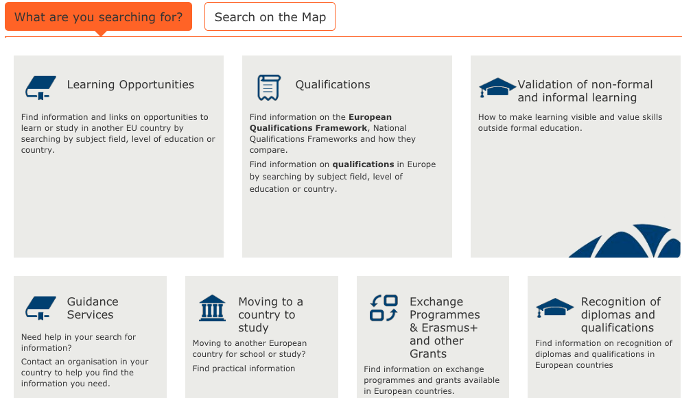

Slide 18
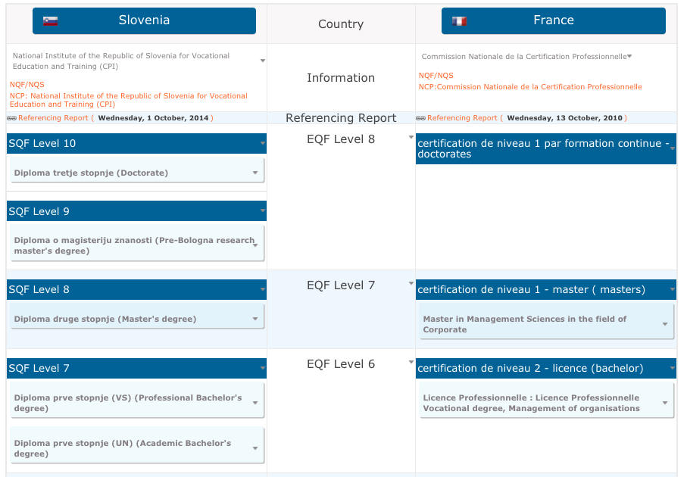

Slide 19
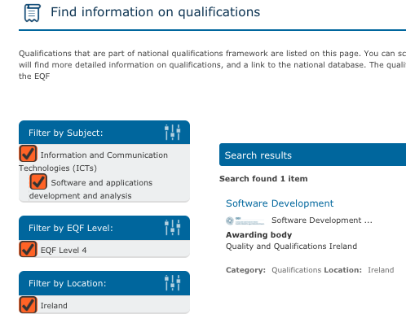

Slide 20
NEW EUROPASS

Slide 21
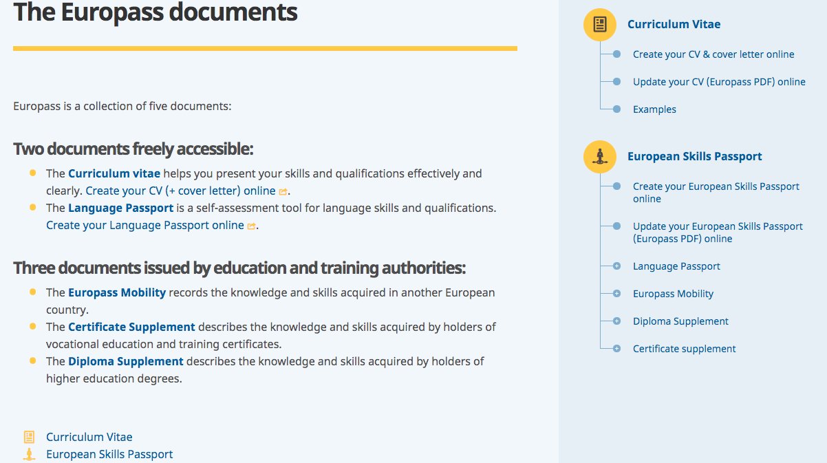

Slide 22
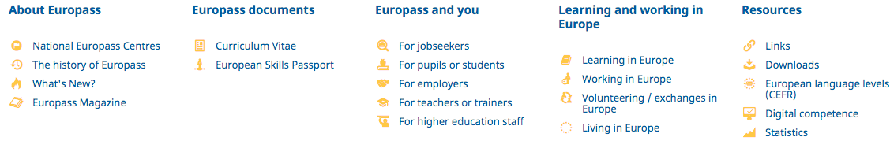
FOOTER

Slide 23
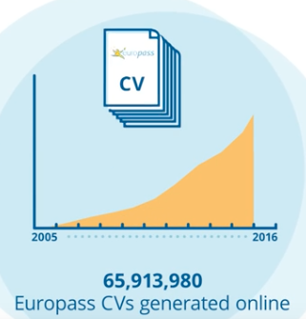
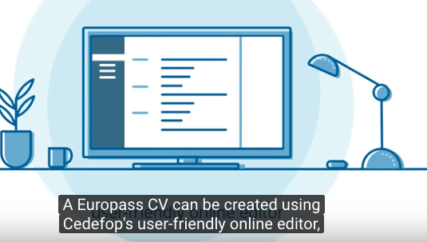
Europass CV big success and more and more linked with job seeker databases

Slide 24
NEW EUROPASS HOMEPAGE FOR INDIVIDUAL USERS
My Europass | Work in Europe | Learn in Europe
Europass e-portfolio Create/ Update Europass CV | How Europass can support job-seeking and career development Searching and Applying for a job Preparing to work abroad Communication your Skills for Work Purposes Career Management | How Europass can support learning Planning your learning Searching and Applying for Learning Opportunities Volunteering Preparing to Learn Abroad Communicating your Skills for Learning Purposes

Slide 25
Europass e-portfolio
guide users to create and manage their personal information and to summarise it in a CV;
compile and store any relevant documentation;
support users to identify their goals and develop their career
present users with personalised learning and job opportunities; and
enable users to prepare, submit and keep track of their learning and job applications.

Slide 26
WHAT CHANGES FOR INDIVIDUALS
NEW SECTION
Qualifications and qualifications frameworks or systems
Development of targeted information (articles and FAQs) for individual end-users .
Transfer and update content from Learning Opportunities and Qualifications in Europe portal

Slide 27
WHAT CHANGES FOR STAKEHOLDERS
Additional for stakeholders
opportunities for validation of non-formal and informal learning:
recognition practices and relevant legislation in different countries,
guidance services for transnational learning mobility and career management:
skills intelligence
Information on skills and qualifications for third country nationals arriving or residing in the Union to support their integration:
Relevant information for stakeholders dealing with Third Country Nationals,

Slide 28
NEW EUROPASS HOMEPAGE CONTENT FOR STAKEHOLDERS
FOOTER
Digitally Signed Credentials | Understanding Skills and Qualifications | Implement Europass
What is the Digital Credentials infrastructure (EDCI)? How to implement the EDCI? | The European Qualifications Framework (EQF) Europass for Education and Training Europass for Employment and Recruitment Europass for Career Guidance | Digital Signed Credentials Interoperability with Europass Europass Tools

Slide 29
Digitally-signed credentials
Digitally-signed credentials are electronic records given to a person to certify the learning they have received.
Europass shall support authentication services for any digital documents or representations of information on skills and qualifications

Slide 30
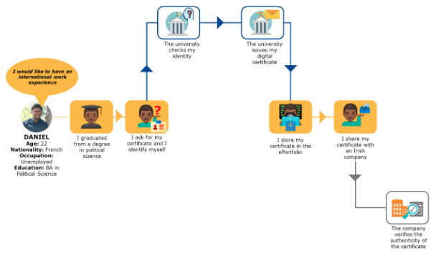
Current situation without digitally signed credentials

Slide 31
BENEFITS OF DIGITALLY SIGNED CREDENTIALS
Daniel automatically receives his degree as a digitally signed credential as soon as he graduates.
The new Europass automatically verifies both that the university is authorized to issue such a degree, and that Daniel is the intended recipient.
Daniel stores this credential either on his own device or in his Europass profile
He can share information on his credential via Europass profile

Slide 32
The Digitally-signed Credentials section introduces the Europass Digitial Credential Infrastructure
The Understanding Skills and Qualifications section
The EQF incl. Learning Opportuntiies and Qualifications in Europe Portal (LOQ)
How Europass tools and information can support education and training actors
How Europass tools and information can support labour market processes
How Europass tools and information can support education, training and employment choices
The Implement Europass section
Information on open standards and how to become interoperable with Europass
Link to the section on digital credentials
How to use and implement Europass tools such as the e-Portfolio including technical documentation for reuse and implementation of Europass tools.

Slide 33
Conclusions
NQF Databases will be linked with other databases
Europass introduces digitally signed credentials and e-portfolio
A single online repository of NQF qualifications at European level, end of separate LOQ and ESCO qualifications repositories
Interoperability ensured through open standard

Slide 34
THANK YOU VERY MUCH

