Slide 1
Development and maintenance of the Qualifications Website and the National Qualifications Framework Register
AnatoliI Garmash, ETF expert
TURIN, 26-28 february 2019
Notes:
Explain what win/win/win is

Slide 2
Action Plan for Implementation of the National Qualifications Framework for the period of 2016–2020
Creation of an efficient system to inform stakeholders of the National Qualifications Framework/National Qualifications System (2016–2020)
Creation and maintenance of the National Qualifications Register for qualifications formally included in the National Qualifications Framework (National Qualifications Framework Register) (2017)
Creation and maintenance of the online National Professional Standard Register/Database (2017)
Creation of the online e-register of professions (occupations) (2018–2019)

Slide 3
National NQF/NQS website
Goal:
Creation of an efficient system to inform stakeholders and the public of formation of the National Qualifications System/implementation of the National Qualifications Framework (NQF)
Objectives (purposes)
Serve as the main reliable and reputable source of information on the National Qualification System (NQS)
Facilitate efficient communication among stakeholders
Create and maintain the National Qualifications Register for qualifications formally included in the National Qualifications Framework

Slide 4
Website users (1)
Key (direct) stakeholders
Government — Ministry of Education and Science of Ukraine, Ministry of Social Policy of Ukraine, other ministries/agencies represented within the Interdepartmental Working Group for the NQF Development and Implementation
Social partners — Joint Representative Body of Employers at the National Level (JRB of Employers), Joint Representative Body of Trade Unions at the National Level
National agencies — National Quality Assurance Agency for Higher Education of Ukraine (NQAAHE), National Qualifications Agency (NQA, draft Law of Ukraine “On Education”)

Slide 5
Website users (2)
Other stakeholders:
Teachers and educational institutions
(teachers and representatives of administrations of higher educational institutions, technical schools/colleges, TVET and other educational institutions/centres)
Learners/ jobseekers
(students and graduates of general education institutions and TVET institutions, students and graduates of higher educational institutions, employed and unemployed persons)
Expert community (academic institutions, academic/training and methodological institutions, other methodological/training centres/institutions, civil society organizations, independent experts and scientists)
Employers, professional associations, trade unions
Examination bodies (external independent testing centres, entities involved in non-formal learning evaluation, certification bodies, personnel certification centres, occupational organizations (professional self-government organizations) issuing own certificates)
Other visitors (ordinary users and civic associations interested in the qualifications system)

Slide 6
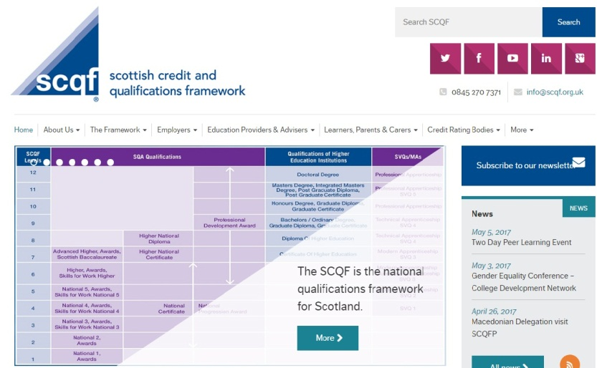
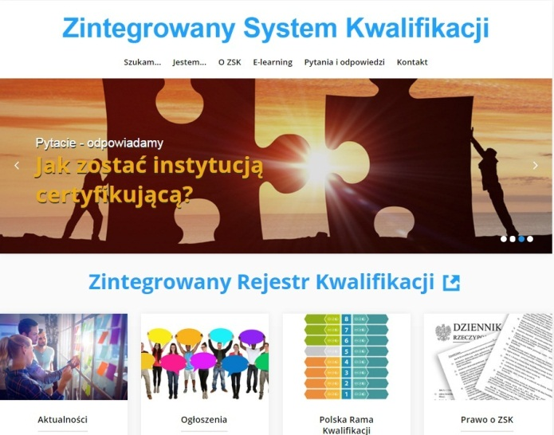
NQF/NQS websites
EQF National Coordination Points (EQF NCP)
Main source of information on the NQF and the National Qualifications System
The NQF/NQS website contains information related to qualifications and the National Qualifications System and serves as a source of relevant information on a one-stop shop basis
http://scqf.org.uk/ http://www.kwalifikacje.gov.pl/

Slide 7
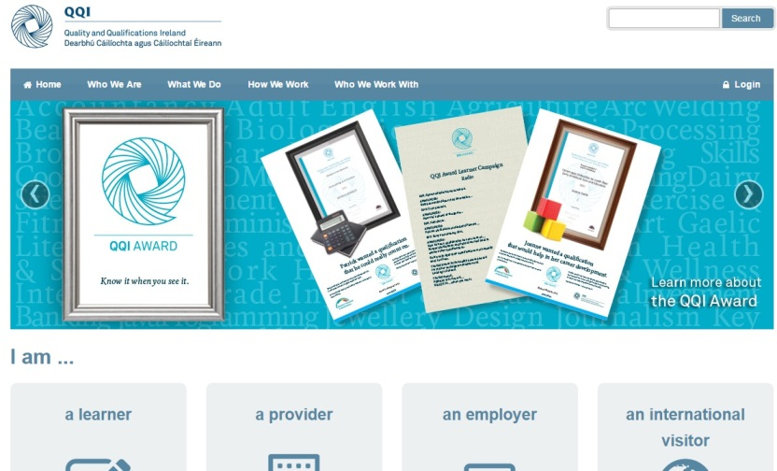
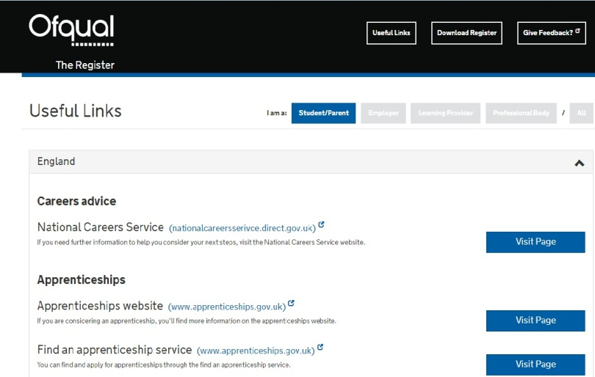
NQF/NQS websites
EQF National Coordination Points (EQF NCP)
Meeting needs of different user categories
The information on the website is arranged according to the needs of different target user categories (employers, educational institutions, students/parents, foreign users etc.)
https://www.qqi.ie/Pages/Home.aspx https://register.ofqual.gov.uk/Links

Slide 8
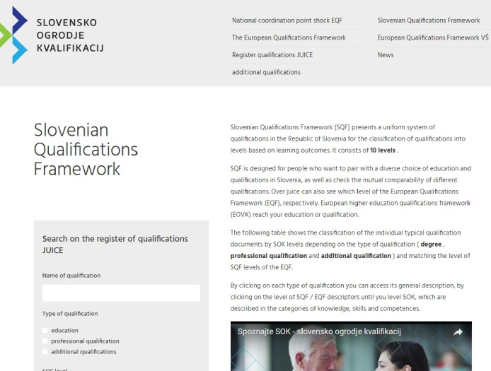
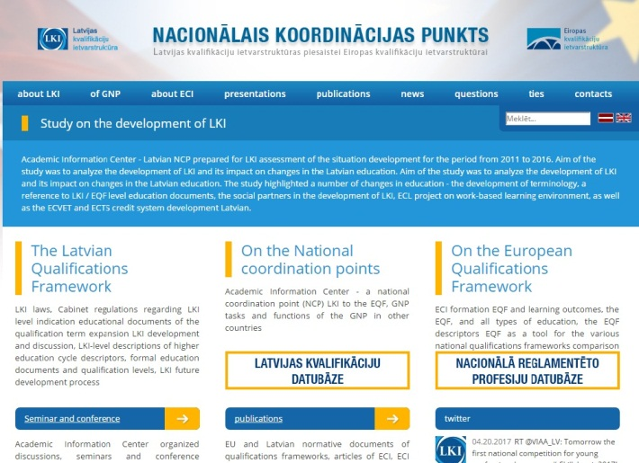
NQF/NQS websites
EQF National Coordination Points (EQF NCP)
Integration with national databases
Online access to databases/national registers is ensured
http://www.nok.si/ http://www.nki-latvija.lv/lv

Slide 9
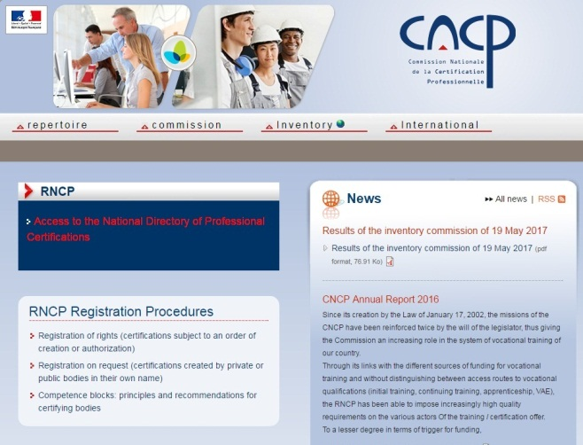
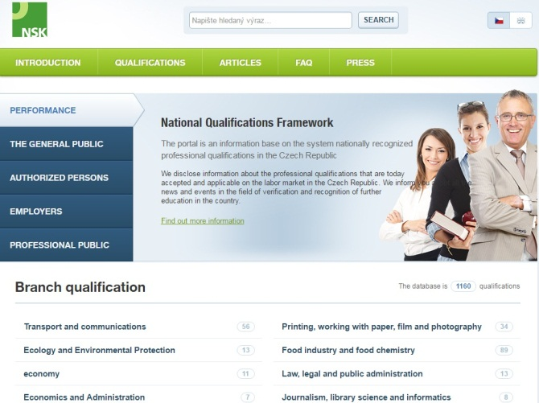
NQF/NQS websites
EQF National Coordination Points (EQF NCP)
Integration with other national and European information resources
Integration with other related information resources at the national and international levels is ensured
http://www.cncp.gouv.fr/ http://www.narodnikvalifikace.cz/

Slide 10

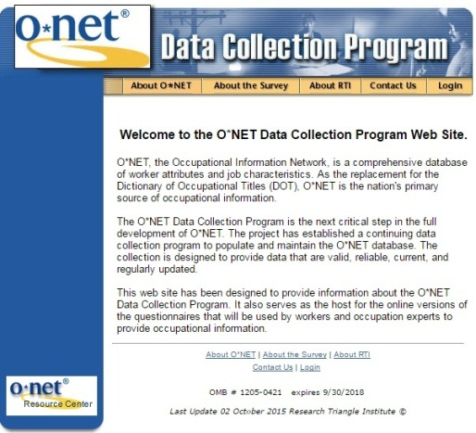
NQF/NQS websites
EQF National Coordination Points (EQF NCP)
Portal for data collection and update
Information required for entering a qualification in the Register is provided. There are relevant tools, including tools for collection of necessary information
http://www.nok.si/ https://onet.rti.org/index.cfm

Slide 11
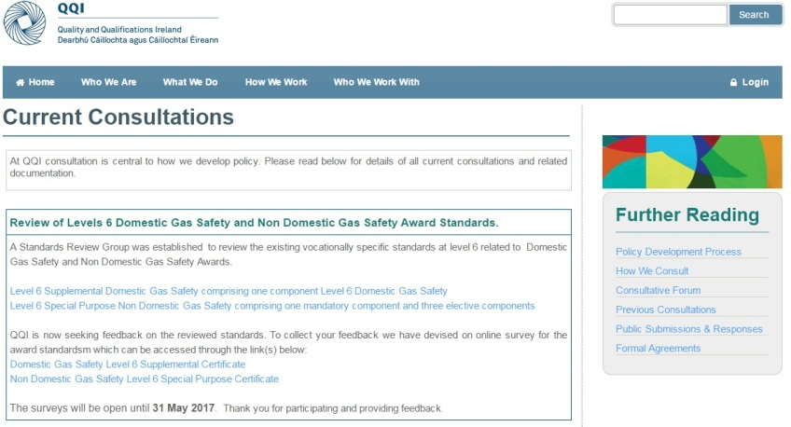
NQF/NQS websites
EQF National Coordination Points (EQF NCP)
Consultation forum for stakeholders
On the website, draft documents (standards) are published for public consultations, there is a possibility for all stakeholders to provide proposals and comments
https://www.qqi.ie/Pages/Home.aspx

Slide 12
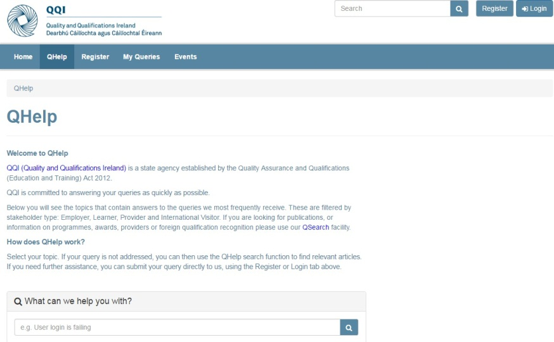
NQF/NQS websites
EQF National Coordination Points (EQF NCP)
Expert platform
Ensuring communication between website users and experts, providing advice related to the NQS, including entering qualifications in the NQF Register
https://qhelp.qqi.ie/ http://scqf.org.uk/

Slide 13
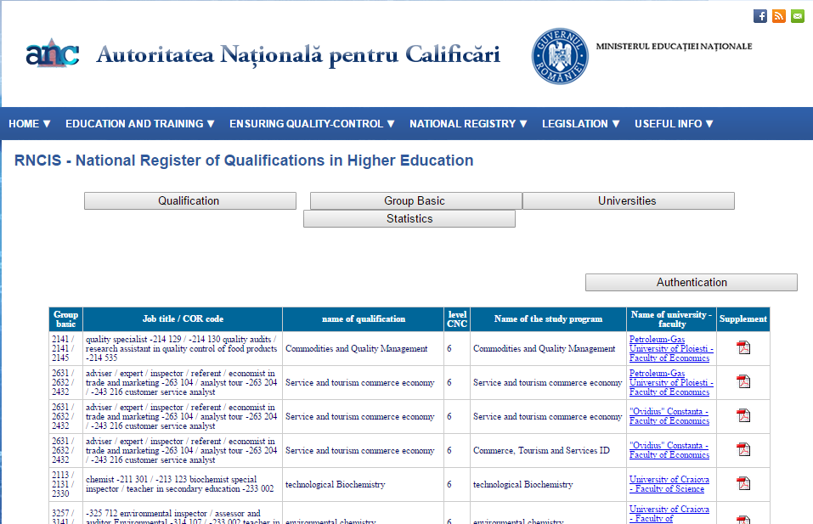
Qualifications registers
Official qualifications database
Only accredited qualifications are entered in the Register (meeting the quality assurance criteria)
http://www.nok.si/ http://www.anc.edu.ro/?page_id=610

Slide 14
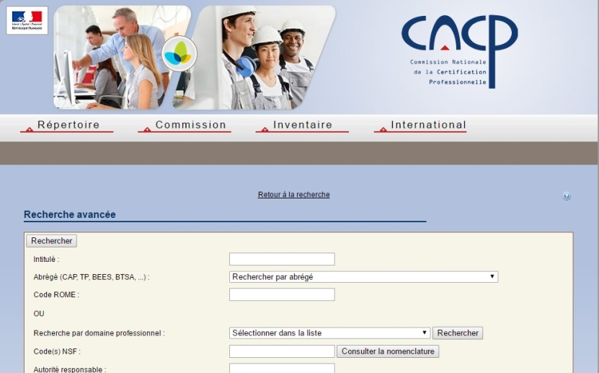
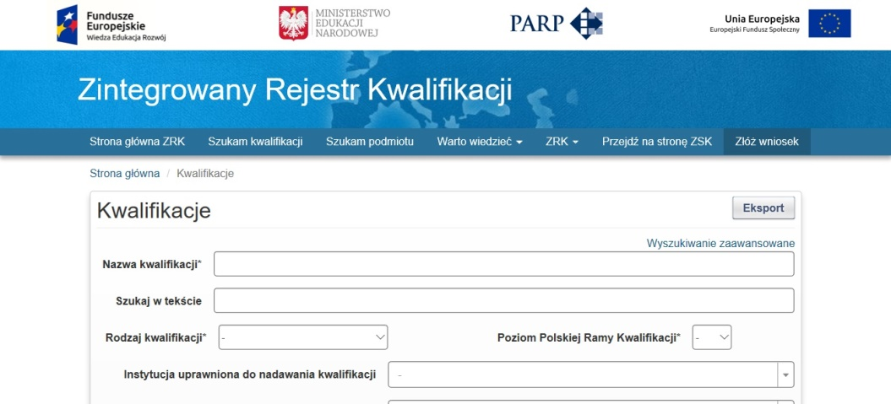
Qualifications registers
Qualification data search with multiple parameters
Qualifications may be searched by name, qualification level/type, awarding body, qualification provider/educational institution, field of education/specialization, professional activity type etc.
http://www.rncp.cncp.gouv.fr/ https://rejestr.kwalifikacje.gov.pl

Slide 15
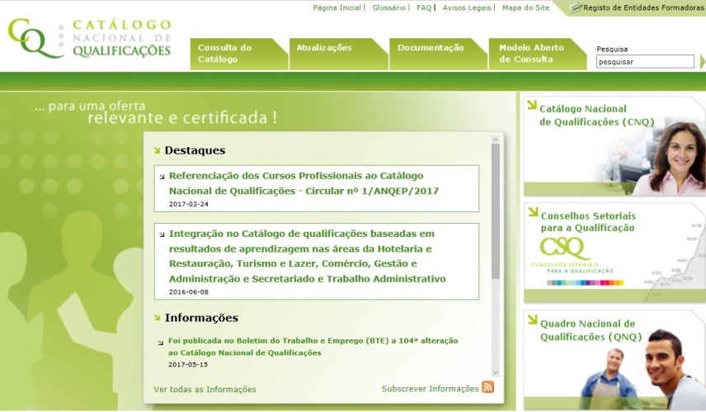
Qualifications registers
Qualifications are described by their key characteristics
Information about qualifications includes a description of learning outcomes, and evaluation criteria. There is information about related documents (professional standards, educational standards/curricula, description of modules etc.) as well as about relevant regulatory documents/decisions.
http://www.narodnikvalifikace.cz/ http://www.catalogo.anqep.gov.pt/Home/Index

Slide 16
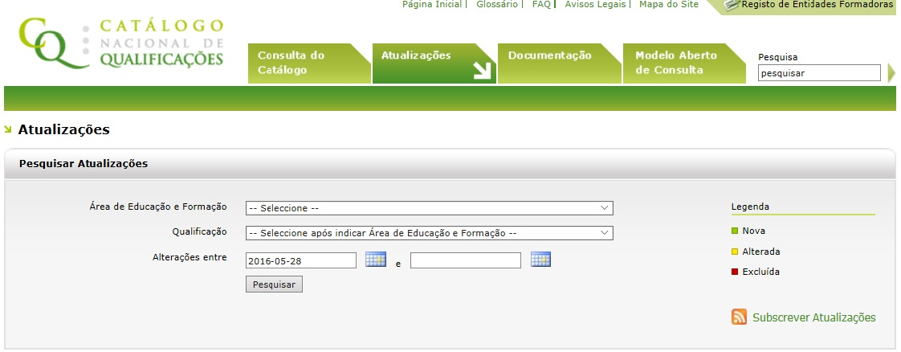
Qualifications registers
The status of qualifications is indicated
It is indicated whether a qualification is valid (can be obtained), newly developed (new), modified or cancelled
http://www.catalogo.anqep.gov.pt/Actualizacoes

Slide 17
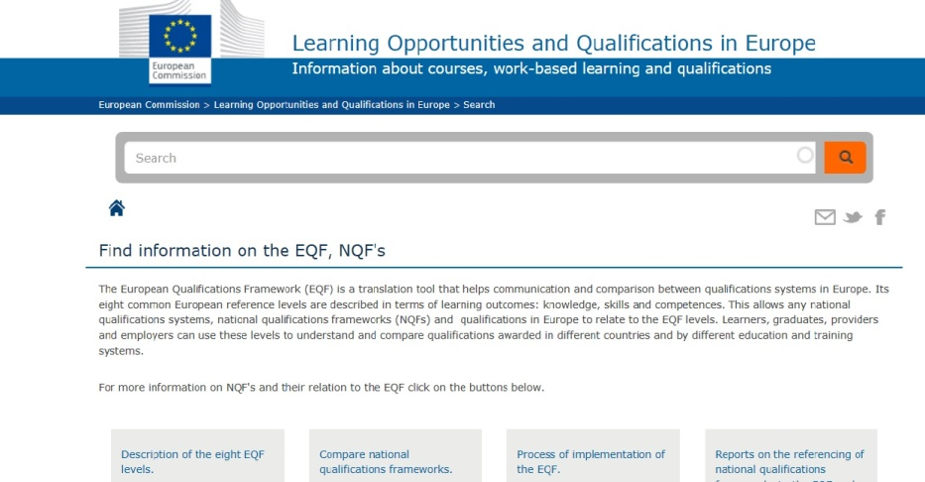
Qualifications registers
Integration with European databases
National registers/databases of national qualifications are integrated with the European Commission’s Learning Opportunities and Qualifications in Europe (PLOTEUS) Portal
https://ec.europa.eu/ploteus/

Slide 18
NQF/NQS websites and Qualifications Registers
Country | NQF website | Qualifications register
Czech Republic | http://www.narodnikvalifikace.cz | http://www.narodnikvalifikace.cz
Estonia | http://kutsekoda.ee/en/index | http://kutsekoda.ee/et/kutseregister/kutsestandardid
Ireland | https://www.qqi.ie/Pages/Home.aspx | http://qsearch.qqi.ie/WebPart/Search?searchtype=awards
Poland | http://www.kwalifikacje.gov.pl/ | https://rejestr.kwalifikacje.gov.pl/en/
Scotland | http://scqf.org.uk/ | http://scqf.org.uk/the-framework/search-database/
Turkey | http://www.myk.gov.tr | http://portal.myk.gov.tr/

Slide 19
NQF/NQS websites and Qualifications Registers
Development and maintenance of the website and of the Qualifications Register
Ministry of Education and Science (Croatia, Germany)
Quality Assurance Agency (Belgium/Flanders, Norway, Sweden)
Qualification Agency/Commission (England, Ireland, Estonia, France, Portugal, Romania, Turkey)
Research Institution/Institute (Czech Republic, Lithuania, Spain, Italy, Slovenia, Slovakia)
National Information Centre ENIC/NARIC (Latvia)
Other education agency/institution (Austria, Finland)
Several institutions (Poland, Scotland)

Slide 20
National sources of information on the NQF/NQS (1)
Information on the NQF implementation
Ministry of Education and Science, NGO “Institute of Professional Qualifications”
Official registers
Unified State Electronic Database on Education (USEDE): registers of educational institutions, training certificates, external independent testing certificates, student IDs
Information on educational standards
Ministry of Education and Science (draft higher education standards)
Verkhovna Rada’s Web Portal (state standards of primary, basic and complete general secondary education)
Information on occupational standards
Ministry of Social Policy, Employers’ Federation of Ukraine

Slide 21
National sources of information on the NQF/NQS (2)
Information on educational institutions and curricula
Ministry of Education and Science
Konkurs Information System http://vstup.info (administered by NGO “Institute of Professional Qualifications”)
private online projects http://osvita.ua/, http://www.education.ua/
websites of educational institutions
Information on recognition of foreign qualifications and training for foreigners in Ukraine
SE “Information and Image Center” (http://enic.in.ua/index.php/ua/ )
Ukrainian State Center for International Education (http://studyinukraine.gov.ua/)

Slide 22
National sources of information on the NQF/NQS (3)
Information on professions
Verkhovna Rada’s Web Portal, private online platforms (Liga.Zakon) (Profession Classifier)
Private online search platforms (Liga.Zakon (http://www.ligazakon.ua), Rabota Plus (https://jobs.ua ), developers’ websites (Qualification Characteristics)
Federation of Employers of Ukraine (Professional Standards)
Information on professional qualifications
Register of Personnel Certification Bodies (National Accreditation Agency of Ukraine)
Websites of certification bodies, professional associations, line ministries
Websites of educational institutions (awarding qualifications to educational institutions)

Slide 23
National sources of information on the NQF/NQS (4)
  Information about the system of validation of non-formal learning outcomes
Ministry of Social Policy, State Employment Service
  Information on career and career guidance
My Career Portal http://mycareer.org.ua/ (UNDP in Ukraine and Ministry of Youth and Sports of Ukraine)
  Information on the labour market situation
State Statistics Service, State Employment Service
State employment centers, non-governmental staffing agencies, private online portals (https://www.work.ua/, www.rabota.ua (information on vacancies)

Slide 24
National sources of information on the NQF/NQS (5)
Information on learning opportunities abroad, exchange programmes, international projects
National Erasmus+ Office (http://erasmusplus.org.ua/)
Ministry of Education and Science of Ukraine
Websites of the EU-funded Tempus/Erasmus+ projects
Private initiatives (Gurt Resource Centre http://gurt.org.ua/)

Slide 25
User expectations
Top search queries (by priority):
- professional standards/qualification characteristics (73%);
- educational standards (72%);
- review of information and analytical materials, legal and methodological framework related to the system of qualifications/education/vocational training (71%);
- curricula (by qualification/specialization) (68%)
- review of draft documents related to qualifications (draft standards, regulations etc. (66%)
- qualifications available within profession (specialization) (66%);
- seeking professional advice (62%).

Slide 26
User expectations (2)
The following bodies are reported to be the most probable creators of the NQF/NQS website (by priority):
- Ministry of Education and Science (67%);
- National Agency for Qualifications (or competent qualifications body) (65%).
The most probable source of funding for the NQF/NQS website development and maintenance — the State Budget funds (60%)

Slide 27
User expectations (3)
Target audience priorities
Teachers and educational institutions
- information on qualifications, educational and professional standards, qualification characteristics, curricula;
review of information and analytical materials, legal and methodological framework;
draft documents related to qualifications.
Learners and/or jobseekers
information on professions, carrier growth opportunities, internship opportunities for professions (specializations), employment and other information on the labour market;
information on qualifications available within a profession (specialization).

Slide 28
User expectations (4)
Expert environment
draft documents related to qualifications;
information about professional standards (qualification characteristics), educational standards, centres that validate qualifications/recognize non-formal learning outcomes
review of information and analytical materials, legal and methodological framework, alternative ways of obtaining qualifications.
Employers
information about centres that validate qualifications/recognize non-formal learning outcomes
review of information and analytical materials, legal and methodological framework;
professional standards/qualification characteristics;
draft documents related to qualifications.

Slide 29
User expectations (5)
Evaluation centres (examination bodies)
information about qualifications, exams (evaluation criteria), centres that validate qualifications/recognize non-formal learning outcomes,
validation of a submitted qualification certificate;
information on professions, career growth opportunities.
Other visitors
information on professions, career growth opportunities,
information about qualifications, educational institutions that award qualifications and centres that validate qualifications/recognize non-formal learning outcomes,
professional advice and alternative ways of obtaining qualifications.

Slide 30
Conclusions and recommendations (1)
None of the existing web resources does not meet the requirements concerning completeness of information and performance to meet the needs of stakeholders related to obtaining necessary information on the National Qualifications System and other services on a one-stop shop basis
Ensure:
interaction of the NQF/NQS website and Qualifications Register with other databases (USEDE), national and European resources on issues related to the NQF/NQS
mandatory provision of the data required for qualification description (Ministry of Education and Science, NAQAHE, Ministry of Social Policy, line ministries/agencies)
official status of the Qualifications Register
use of the NQF/NQS website to support inclusion of new qualifications on the Qualifications Register (support for working groups’ activities, public discussion of draft documents, expert assistance, information and consultation services)

Slide 31
Conclusions and recommendations (2)
Maintenance of the NQF/NQS website and of the Qualifications Register shall be joint responsibility of stakeholders.
The NQF/NQS website and the Qualifications Register may be created by key (direct) stakeholders:
Government: Ministry of Education and Science, Ministry of Social Policy;
social partners: JRB of Employers at the National Level, JRB of Trade Unions at the National Level.
After the National Qualifications Agency (NQA) is established, it may be entrusted with the website/register operation.

Slide 32
Road map (1)
Phase | Term | Tasks | NQF Action Plan
1. Development of the website/Qualifications Register | 2018-2019 | Identification of the web development company to perform the tasks Development of the website and Qualifications Register Adjustment of the technical specification Development of the draft (demo) version | Para. 9. Creation and maintenance of the National Qualifications Register for qualifications formally included in the National Qualifications Framework (National Qualifications Framework Register)
2. Pilot operation of the website/Qualifications Register |  | Filling in the content (both text and graphics) Development of the initial data base Checking the positions of qualifications in the Qualifications Register Synchronizing the Register data with other data bases (i.e. USEDE) | Para. 9. Development of the procedure of including qualifications into the National Qualifications Framework Register
3. Official launch of the platform/NQF Register (2018) | 2019 | Maintainance and technical support of the website/Register | Para. 21. Creation of an efficient system to inform stakeholders of the National Qualifications Framework/National Qualifications System (2016–2020)

Slide 33
Road map (2)
Phase | Term | Tasks | NQF Action Plan
4. Operation of the website/Qualifications Register | 2019–2020 | New/updated qualifications included into the Register Forming on tht basis of the website/NQF Register: register of professional standards register of the qualification centres/awarding bodies register of certificates on professional qualifications awarded | Para. 8. Development and operation of the online National Register/data base of professionsl standards
 |  |  | Para. 7. Creation of the online e-register of professions (occupations)
5 The NQF self-certification and integration of the Qualifications Register/ curricula database with the European Commission’s PLOTEUS Portal | 2019 | Para. 24. Use of information about the National Qualifications Framework in transcripts of higher education and TVET certificates | Para. 22-23. Aligning the National Qualifications Framework with the criteria of the European Qualifications Framework for Lifelong Learning and the Framework for Qualifications of the European Higher Education Area Para. 25. Use of the National Qualifications Framework as a tool for recognizing foreign qualifications

Slide 34
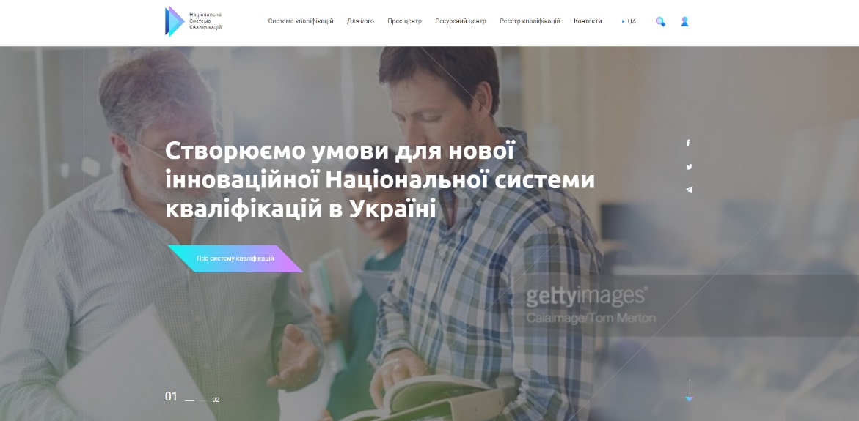
Development of the NQS website
Website http://markup.etf.com.dev11.vintagedev.com.ua/
Prototype: https://1pwx97.axshare.com Password: Vintage_ETF
Two basic types of users: regular users and members of the working groups
Flexible page constructor
Sections editor
Data base for storage and search of methodical, research and analytical materials.

Slide 35
Development of the NQS website
Home page
  https://1pwx97.axshare.com/#g=1&p=00__home
Cabinet for the members of working groups
  https://1pwx97.axshare.com/#g=1&p=3__for_admin
For Whom
  https://1pwx97.axshare.com/#g=1&p=4__for_who
Qualifications system
  https://1pwx97.axshare.com/#g=1&p=9__qualification_system
Press Centre
  https://1pwx97.axshare.com/#g=1&p=16__press_center
Resource Centre
  https://1pwx97.axshare.com/#g=1&p=25__resource_center
Advise Platform
  https://1pwx97.axshare.com/#g=1&p=31__advisory_platform

