Slide 1

Qualifications in a Lifelong Learning Perspective: the Role of Validation
Maria Rosenstock
Support to the establishment of Israel NQF | 23. September | ETF, Turin

Slide 2
lifelong learning -
- eSSENCE
  Lifelong: learning at each stage of life
  Lifewide: learning in different contexts
  Open approach to qualifications:
    All learning no matter when and how acquired should be made visible and valued
  Learning concerns everybody
  Learner in the centre
  Partnership for LLL
All learning activity undertaken throughout life, which results in improving knowledge, know-how, skills, competences and/or qualifications for personal, social and/or professional reasons. (Cedefop)

Slide 3
instruments
GOALS
  Education system reforms
  Assuring opportunities for good quality learning
  Validating learning outcomes
  Opening pathways for flexible transitions
  Facilitating links
  Adult learning
  Promotion of training programs in different forms
  Qualification systems reform
  Validation
  …

Slide 4
EU POLICIES (1)
"Education and Training 2020" (ET 2020) is a strategic framework for European cooperation in education and training.
8 benchmarks:
An average of at least 15 % of adults should participate in lifelong learning.
The share of low-achieving 15-year-olds in reading, mathematics and science should be less than 15 %.
The share of 30-34 year-olds with tertiary educational attainment should be at least 40 %.
The share of early leavers from education and training should be less than 10 %.
At least 95 % of children between 4 years old and the age for starting compulsory primary education should participate in early childhood education.
The share of employed graduates (20-34 year-olds) having left education and training 1-3 years before the reference year should be at least 82 %.
An EU average of at least 20 % of higher education graduates should have had a period of higher education-related study or training (including work placements) abroad, representing a minimum of 15 ECTS credits or lasting a minimum of three months.
An EU average of at least 6 % of 18-34 year-olds with an initial vocational education and training (IVET) qualification should have had an IVET-related study or training period (including work placements) abroad lasting a minimum of two weeks, or less if documented by Europass.

Slide 5
EU POLICIES (2)
The new Skills Agenda for Europe, adopted by the Commission in 2016, launched 10 actions to make the right training, skills and support available to people in the EU.
1. Upskilling Pathways: New Opportunities for Adults
2. European Qualifications Framework
3. Digital Skills and Jobs Coalition
4. Blueprint for Sectoral Cooperation on Skills
5. EU Skills Profile Tool Kit for Third-Country Nationals
6. Vocational education and training (VET)
7. Key competences
8. Europass
9. Graduate Tracking
10. Analysing and sharing of best practice on brain flows

Slide 6
Modernised qualifications frameworks
- instrumentS of lll policy
Before 2005 – NQFs in 3 European countries (Ireland, France and UK)
2008 Recommendation on the European Qualifications Framework for lifelong learning
EQF is a common European reference framework:
to make qualifications more readable and understandable across different countries and systems.
covers qualifications at all levels and in all sub-systems of education and training,
39 European countries currently involved in its implementation.
2017 Revised and strengthened Recommendation on the EQF The purpose of this revised recommendation is to ensure the continuity as well as a further deepening of the EQF.
ETF partner countries followed – Inventory (Google: ‘qualifications platform’)
https://connections.etf.europa.eu/wikis/home?lang=en#!/wiki/Wf591e43b607e_4ccf_8d94_a3256a255147/page/NQF%20Inventories

Slide 7
QUALIFICATIONS FRAMEWORK OR QUALIFICATIONs SYSTEM
?
Do the current qualifications adequately facilitate lifelong learning?
Are we describing qualifications or are we changing them?
Will classifying of the qualifications assure the bridging function?

Slide 8
QUALIFICATION SYSTEMS REFORM
Development, classification and description of qualifications (by different sub-systems)
Credit accumulation and transfer
Using qualifications:
  Learning ‘From delivering training to enabling learning’
  Assessment (including validation)
Quality assurance of qualifications
REGISTER (communication)
Governance: strategic and operational funtions
LEARNING OUTCOMES

Slide 9
Initial stage of reform –
- TYPICAL CONCERNS/bOTTLENECKS
Concerns over the potential impact on the exisitng education and higher education systems - will the education and academic traditions be upheld?
Impact on the workload of the existing institutions
Will new institutions be needed?
Costs (starting costs and sustainable financing)
... (more in ETF Toolkit)

Slide 10
Studies on impact of NQFs
Early impact:
Less impact:
    Improved transparency of qualifications systems (through learning-outcomes)
    More consistent implementation of learning outcomes
    Linking NQFs with validation
    Greater stakeholders engagement
    Opening to qualifications awarded outside of formal education
    Increased visibility of higher vocational qualifications
  Limited use by labour market actors
  Articulation (bridging function)
  Institutional reforms
  Recognition across countries

Slide 11
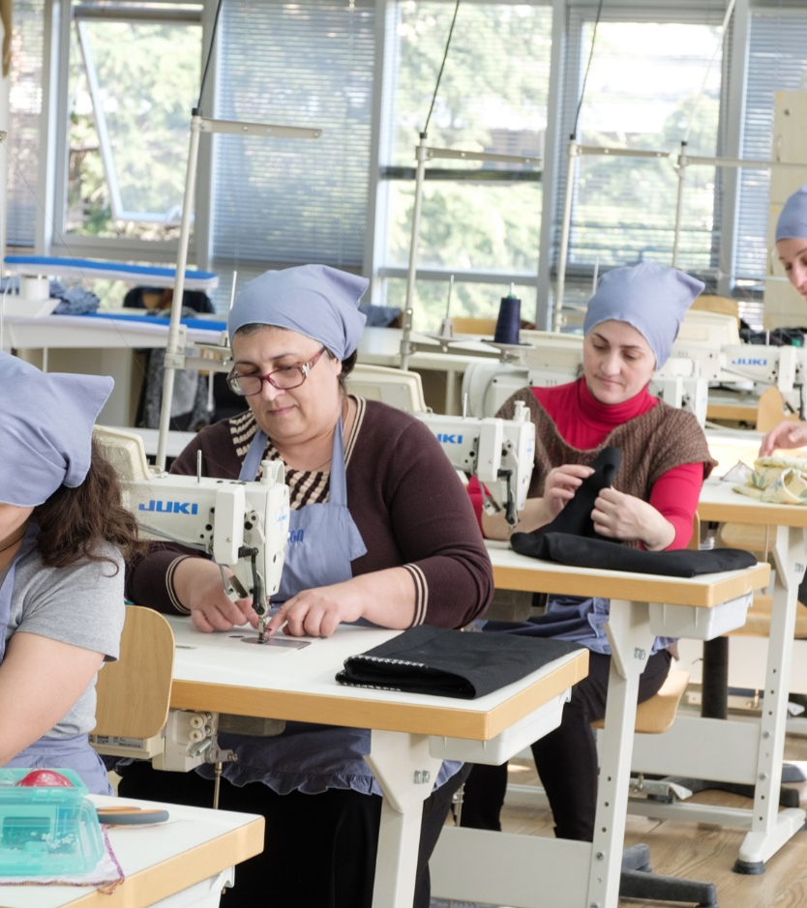
Validation – link to NQFs
endorsement of NQFs policies and laws = the adoption of principle of recognition and validation (VNFIL)
requirement that the new qualifications included in the national registers offer awarding through validation.
possible when qualifications are described in learning outcomes

Slide 12

Validation context:
in education & training
in enterprises
in labour market (skills audit)
in voluntary sector

Slide 13
VALIDATION (VNFIL) - European perspective
The 2012 Council Recommendation on validation encourages Member States to put in place national arrangements for validation by 2018.
These arrangements will enable individuals to increase the visibility and value of their knowledge, skills and competences acquired outside formal education and training: at work, at home or in voluntary activities.
http://eur-lex.europa.eu/LexUriServ/LexUriServ.do?uri=OJ:C:2012:398:0001:0005:EN:PDF

Slide 14
Validation of informal and non-formal learning
(VNFIL)
‘A process of confirmation by an authorised body that an individual has acquired learning outcomes measured against a relevant standard’
(2012 Recommendation)

Slide 15
Validation stages
Identification - Validation starts with the identification of knowledge, skills and competence acquired, through dialogue with the candidate. In the identification phase, it becomes clear what the reference standard is of the validation process.
Documentation – In the documentation phase, the candidate makes the identified knowledge, skills and competences visible. The candidate provides evidence of the acquired learning outcomes based on the reference standard.
Assessment – An authorised body assesses the evidence that the candidate has provided in the documentation phase and compares it with the reference standard. Assessment can take many different forms.
Certification – An authorised body certifies the results of the assessment. The certification includes a statement of achieved learning outcomes against the reference standard. This may lead to a partial or full qualification or an advice for further training to acquire a partial or full qualification.

Slide 16
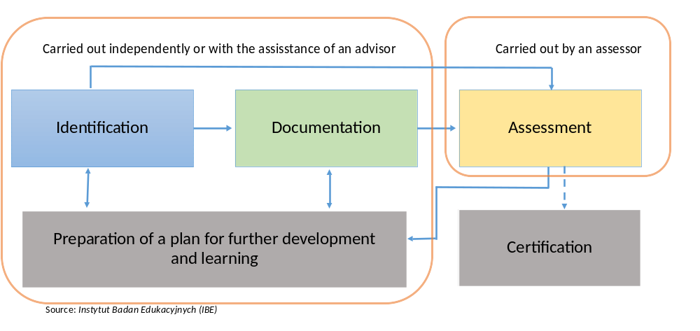
Validation process

Slide 17
Assessment methods
Assessing learning acquired outside of traditional education and training systems often requires alternative methods
http://walidacja.ibe.edu.pl/metody/en/
User friendly catalogue of validation methods

Slide 18
Validation – CONDITIONS FOR IMPLEMENTATION
Information, Guidance and counselling
Coordination of stakeholders
Links to national qualifications and frameworks
Standards and learning outcomes
Quality assurance
The professional competences of validation practitioners
Funding

Slide 19
Validation – ETF work in partner countries
ETF partner countries are currently investing substantially in development of open and accessible validation systems.
ETF supported drafting regulations on validation in a number of partner countries: Albania, Kosovo, North Macedonia, Turkey, and recently Azerbaijan.
Most of our partner countries are not advanced on setting up the validation systems.
Turkey:
operational system in place to assess, evaluate and certify skills of adults against national vocational qualifications with hundreds of assessment centres run by the private public and non-government sectors.
focus on empowering employees in the sector, to improve their qualifications and obtain the VQA certification.

Slide 20
Validation – Bodies in charge (exercise)
https://www.cedefop.europa.eu/en/events-and-projects/projects/validation-non-formal-and-informal-learning
CEDEFOP, VALIDATION
European Inventory
&
Database

Slide 21
ValidatioN – EXERCISE
Countries:
  France
  Turkey
  Portugal
  UK (Scotland)
  Questions:
  Main target group?
  Main bodies delivering VNFIL?
  Challenges?

Slide 22
ValidatioN – bodies in charge
Increasing recognition of the importance of combining services for marginalised groups in a community-based location as one-stop shop multidisciplinary teams

Slide 23
ValidatioN – ETF self assessment tool
https://www.etfqual.eu/wp-content/uploads/2018/03/SAT_validation_EN.pdf

Slide 24
case story
https://scqf.org.uk/case-studies/my-learning-journey-lisas-story/
https://scqf.org.uk/case-studies/my-learning-journey-jons-story/

Slide 25


